Slide 1
A Journey in Support of the Cuban People
The Friendship Association
October 13-26, 2022

Slide 2
We traveled to Cuba at a time unparalleled since the “Special Period” of the 1990s. Due to the U.S. Embargo, COVID, the explosion of the Matanzas oil tanks, decline in fuel deliveries from Venezuela and the subsequent lack of tourists, upon which Cuba depends, there is a shortage of food, fuel for transportation and power for electricity, as well as an ongoing shortage of many other items. To escape these conditions, there has been a mass exodus of people from the country, which continues today.
The monetary system is confusing and changeable. The average Cuban does not have access to many items like new appliances, electronics, etc. if they do not have a special MCR card which allows their purchase. These cards can only be purchased with Euros, which most people do not have. We used primarily Cuban pesos and U.S. dollars for our purchases.
At this point planes may only fly into Havana, requiring a two-day bus ride to our primary area of interest of this trip, in the far east of the country in the municipality of Guantánamo.
In spite of these challenges, the social and economic conditions do not detract from the beauty of the landscape or from the warmth, welcome and spirit of the people.

Slide 3
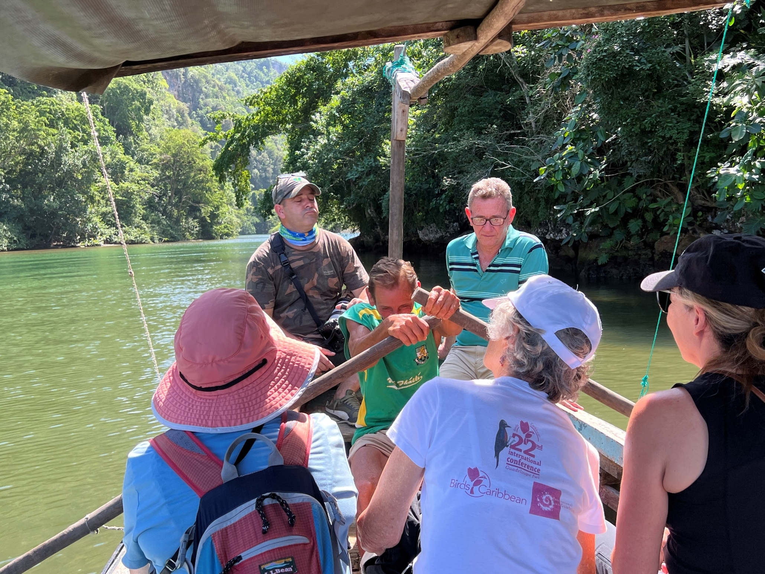
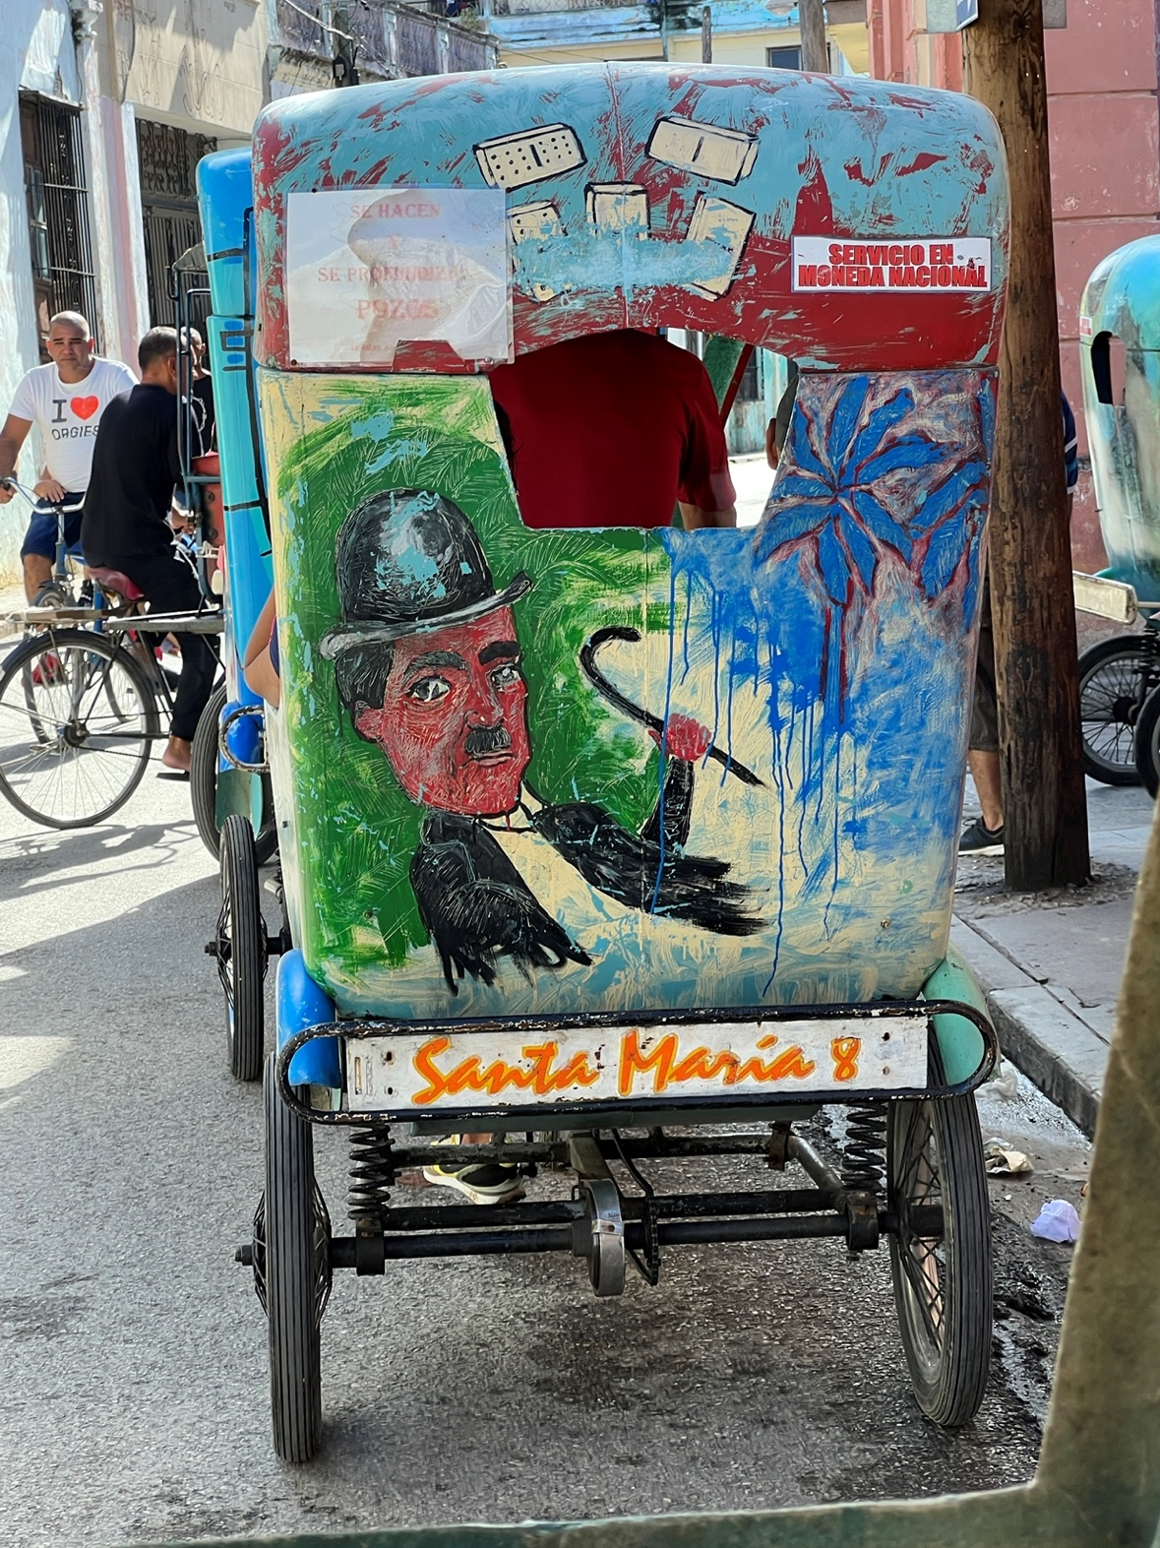
How We Support the Cuban People
Transportation—we hire private bici-taxi drivers, boatmen and support our bus driver.
Yumuri River, near Baracoa
Camagüey

Slide 4
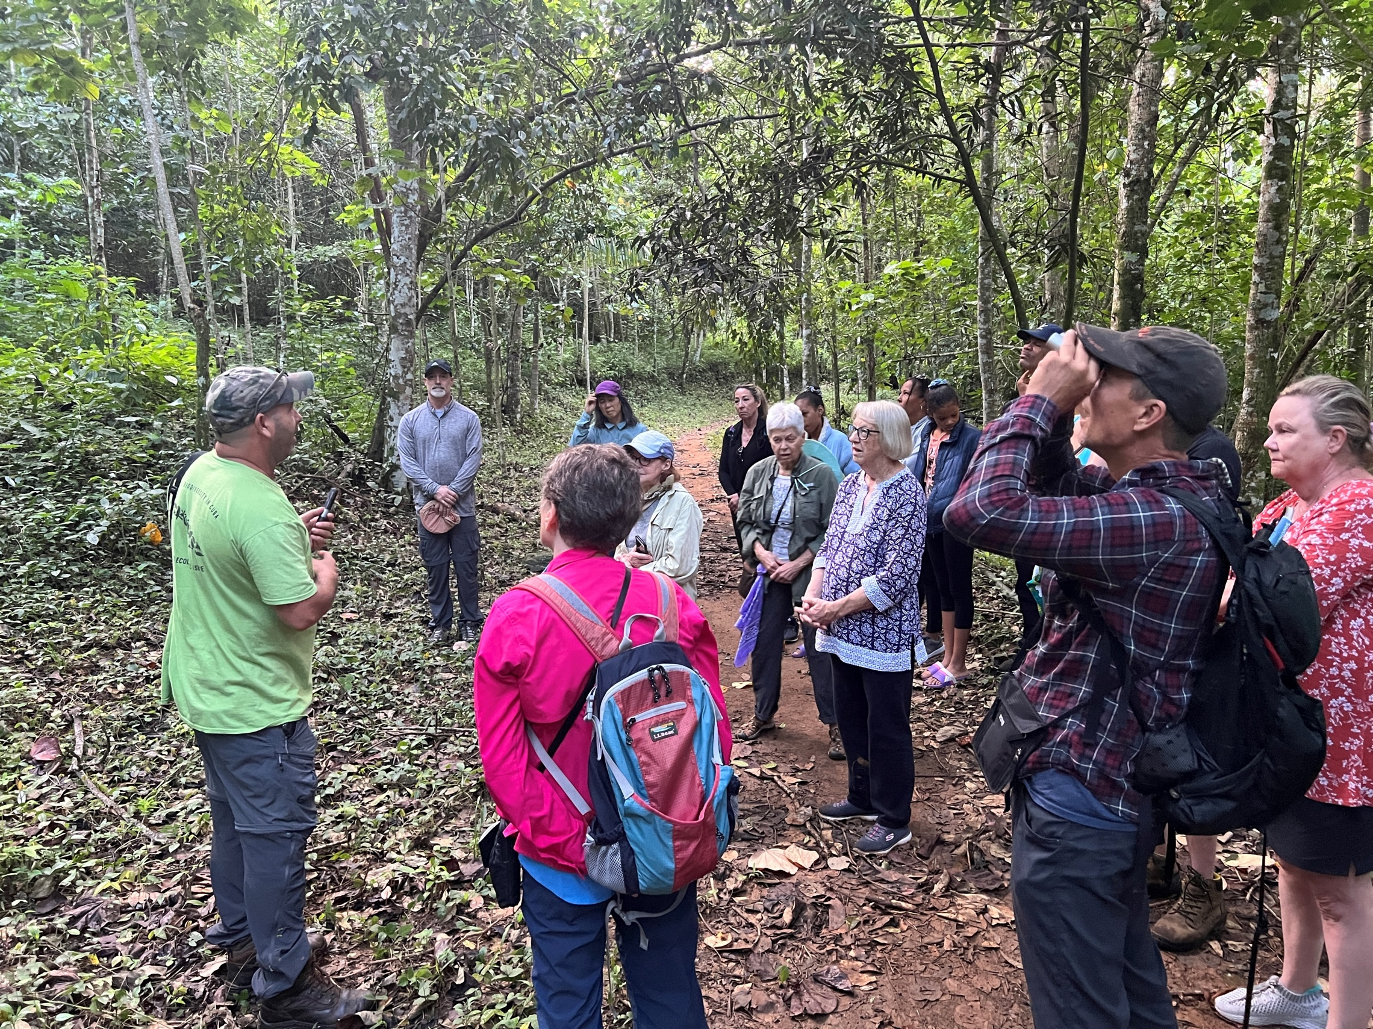
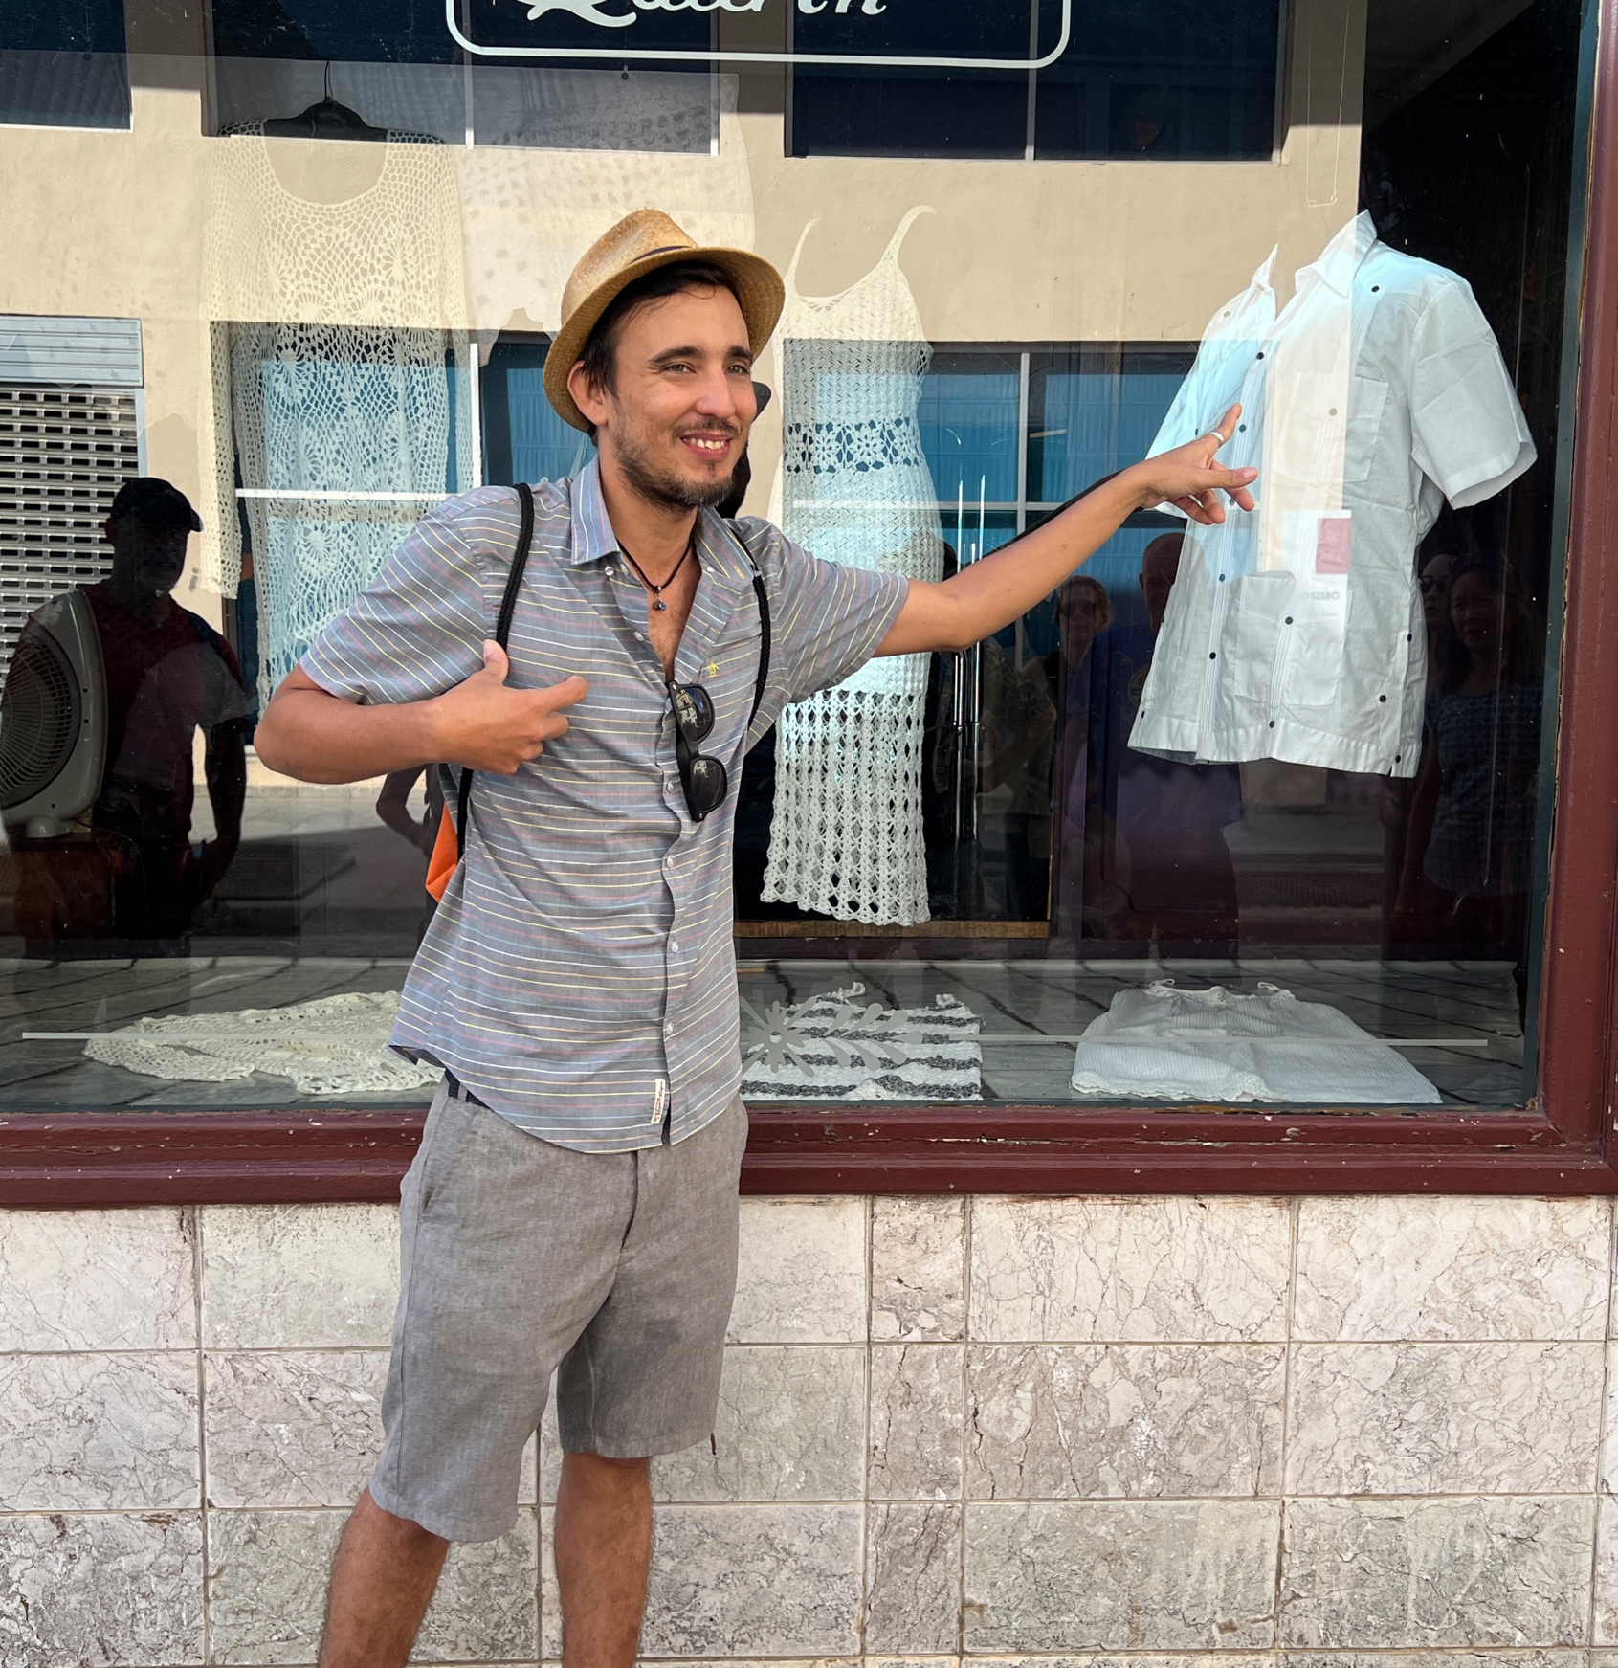
We hire local guides
Maikal Cañizares, biologist, leads us on a hunt for endemic birds
Rubén Pérez tells the story of the guayabera
shirt on our Old Havana tour.

Slide 5
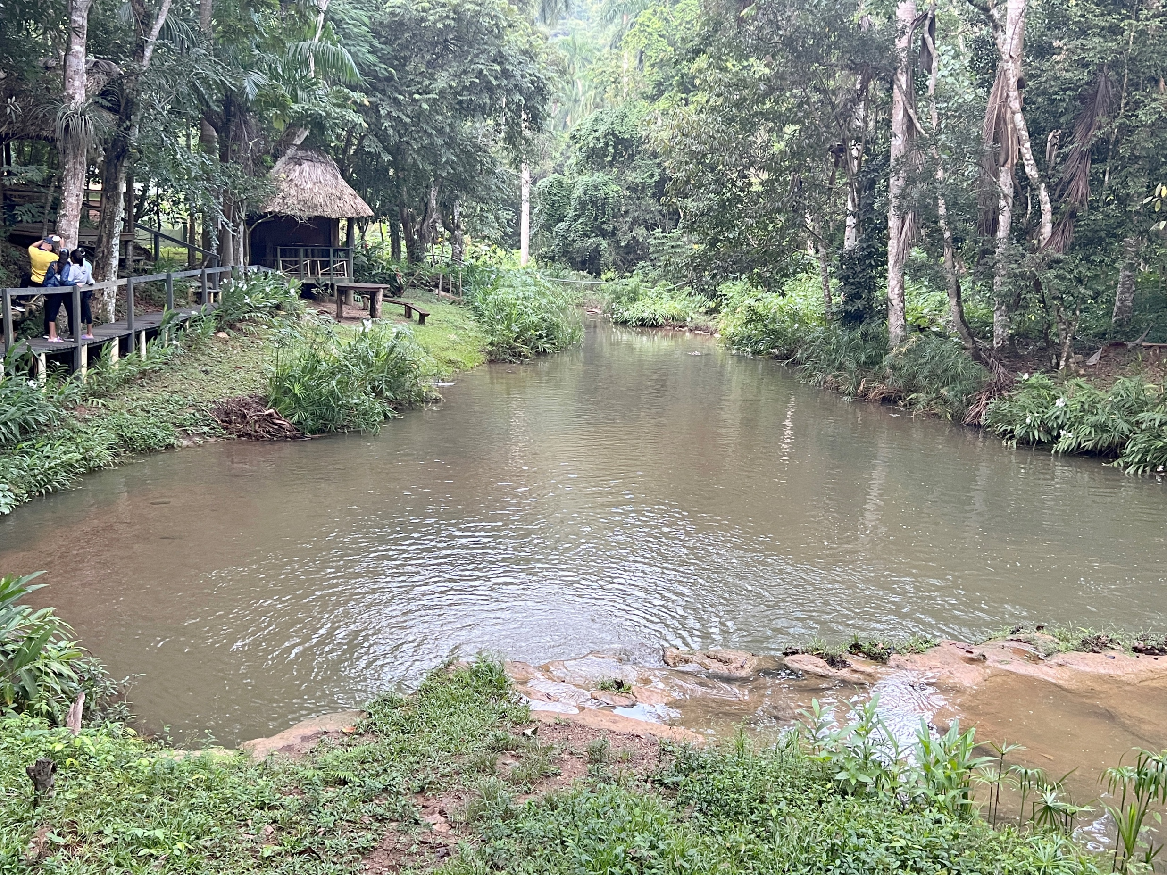
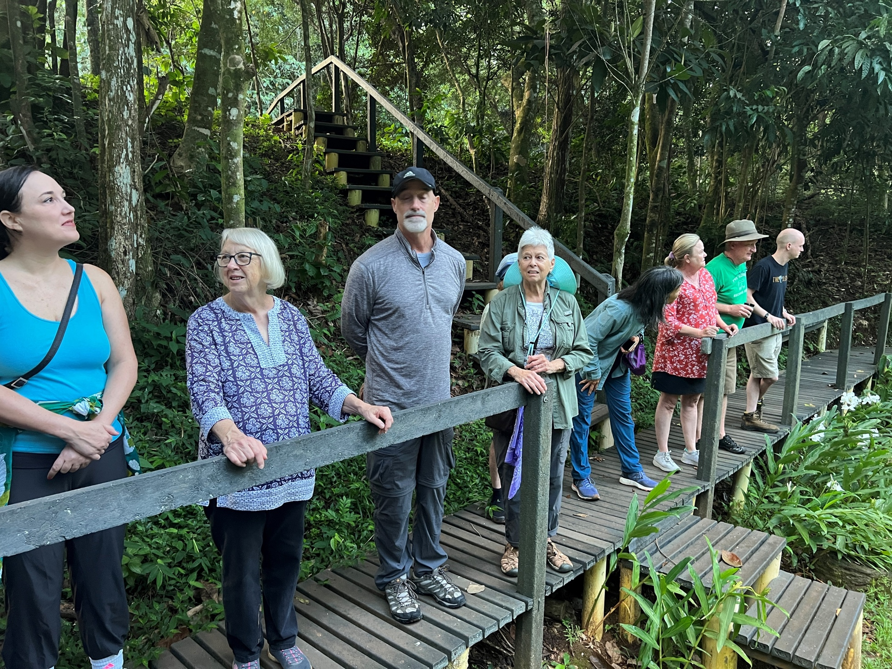
Alturas de Banao, a nature reserve located
in the mountains of Guamuhaya, just outside of Santi Spritus.
Maikal leads us and shares his work with us.

Slide 6
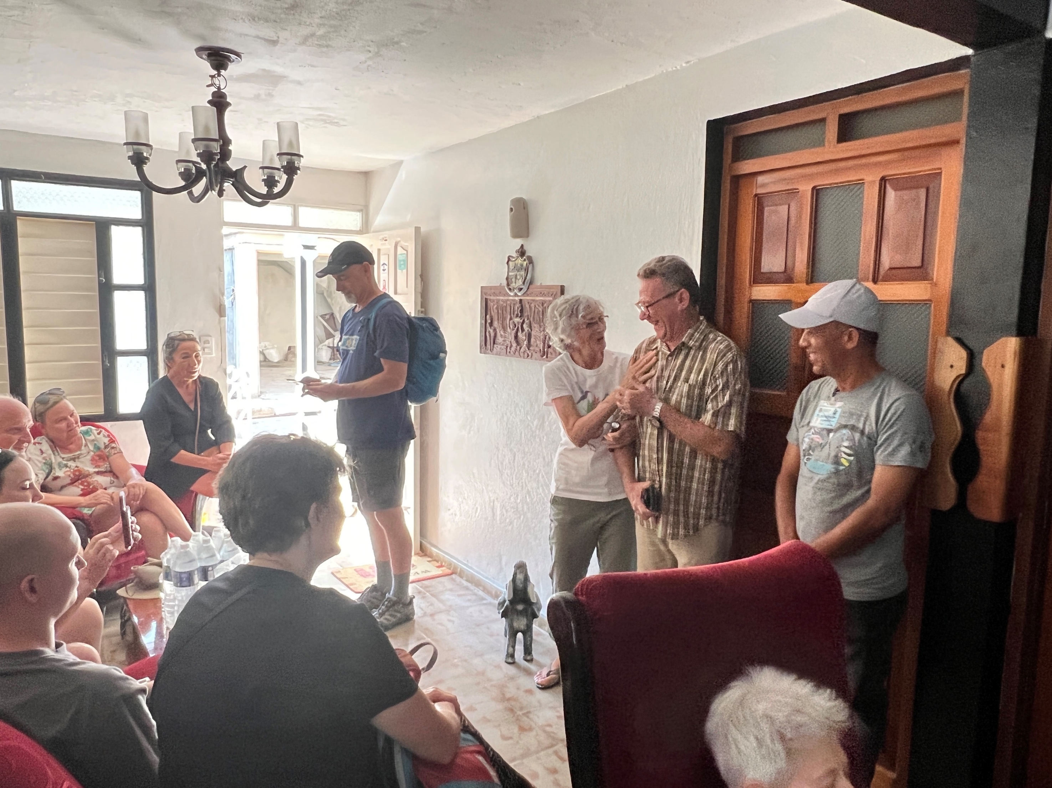
Soledad introduces us to Elexis Fernandez and José Florián, who introduce us to their town of Baracoa.

Slide 7
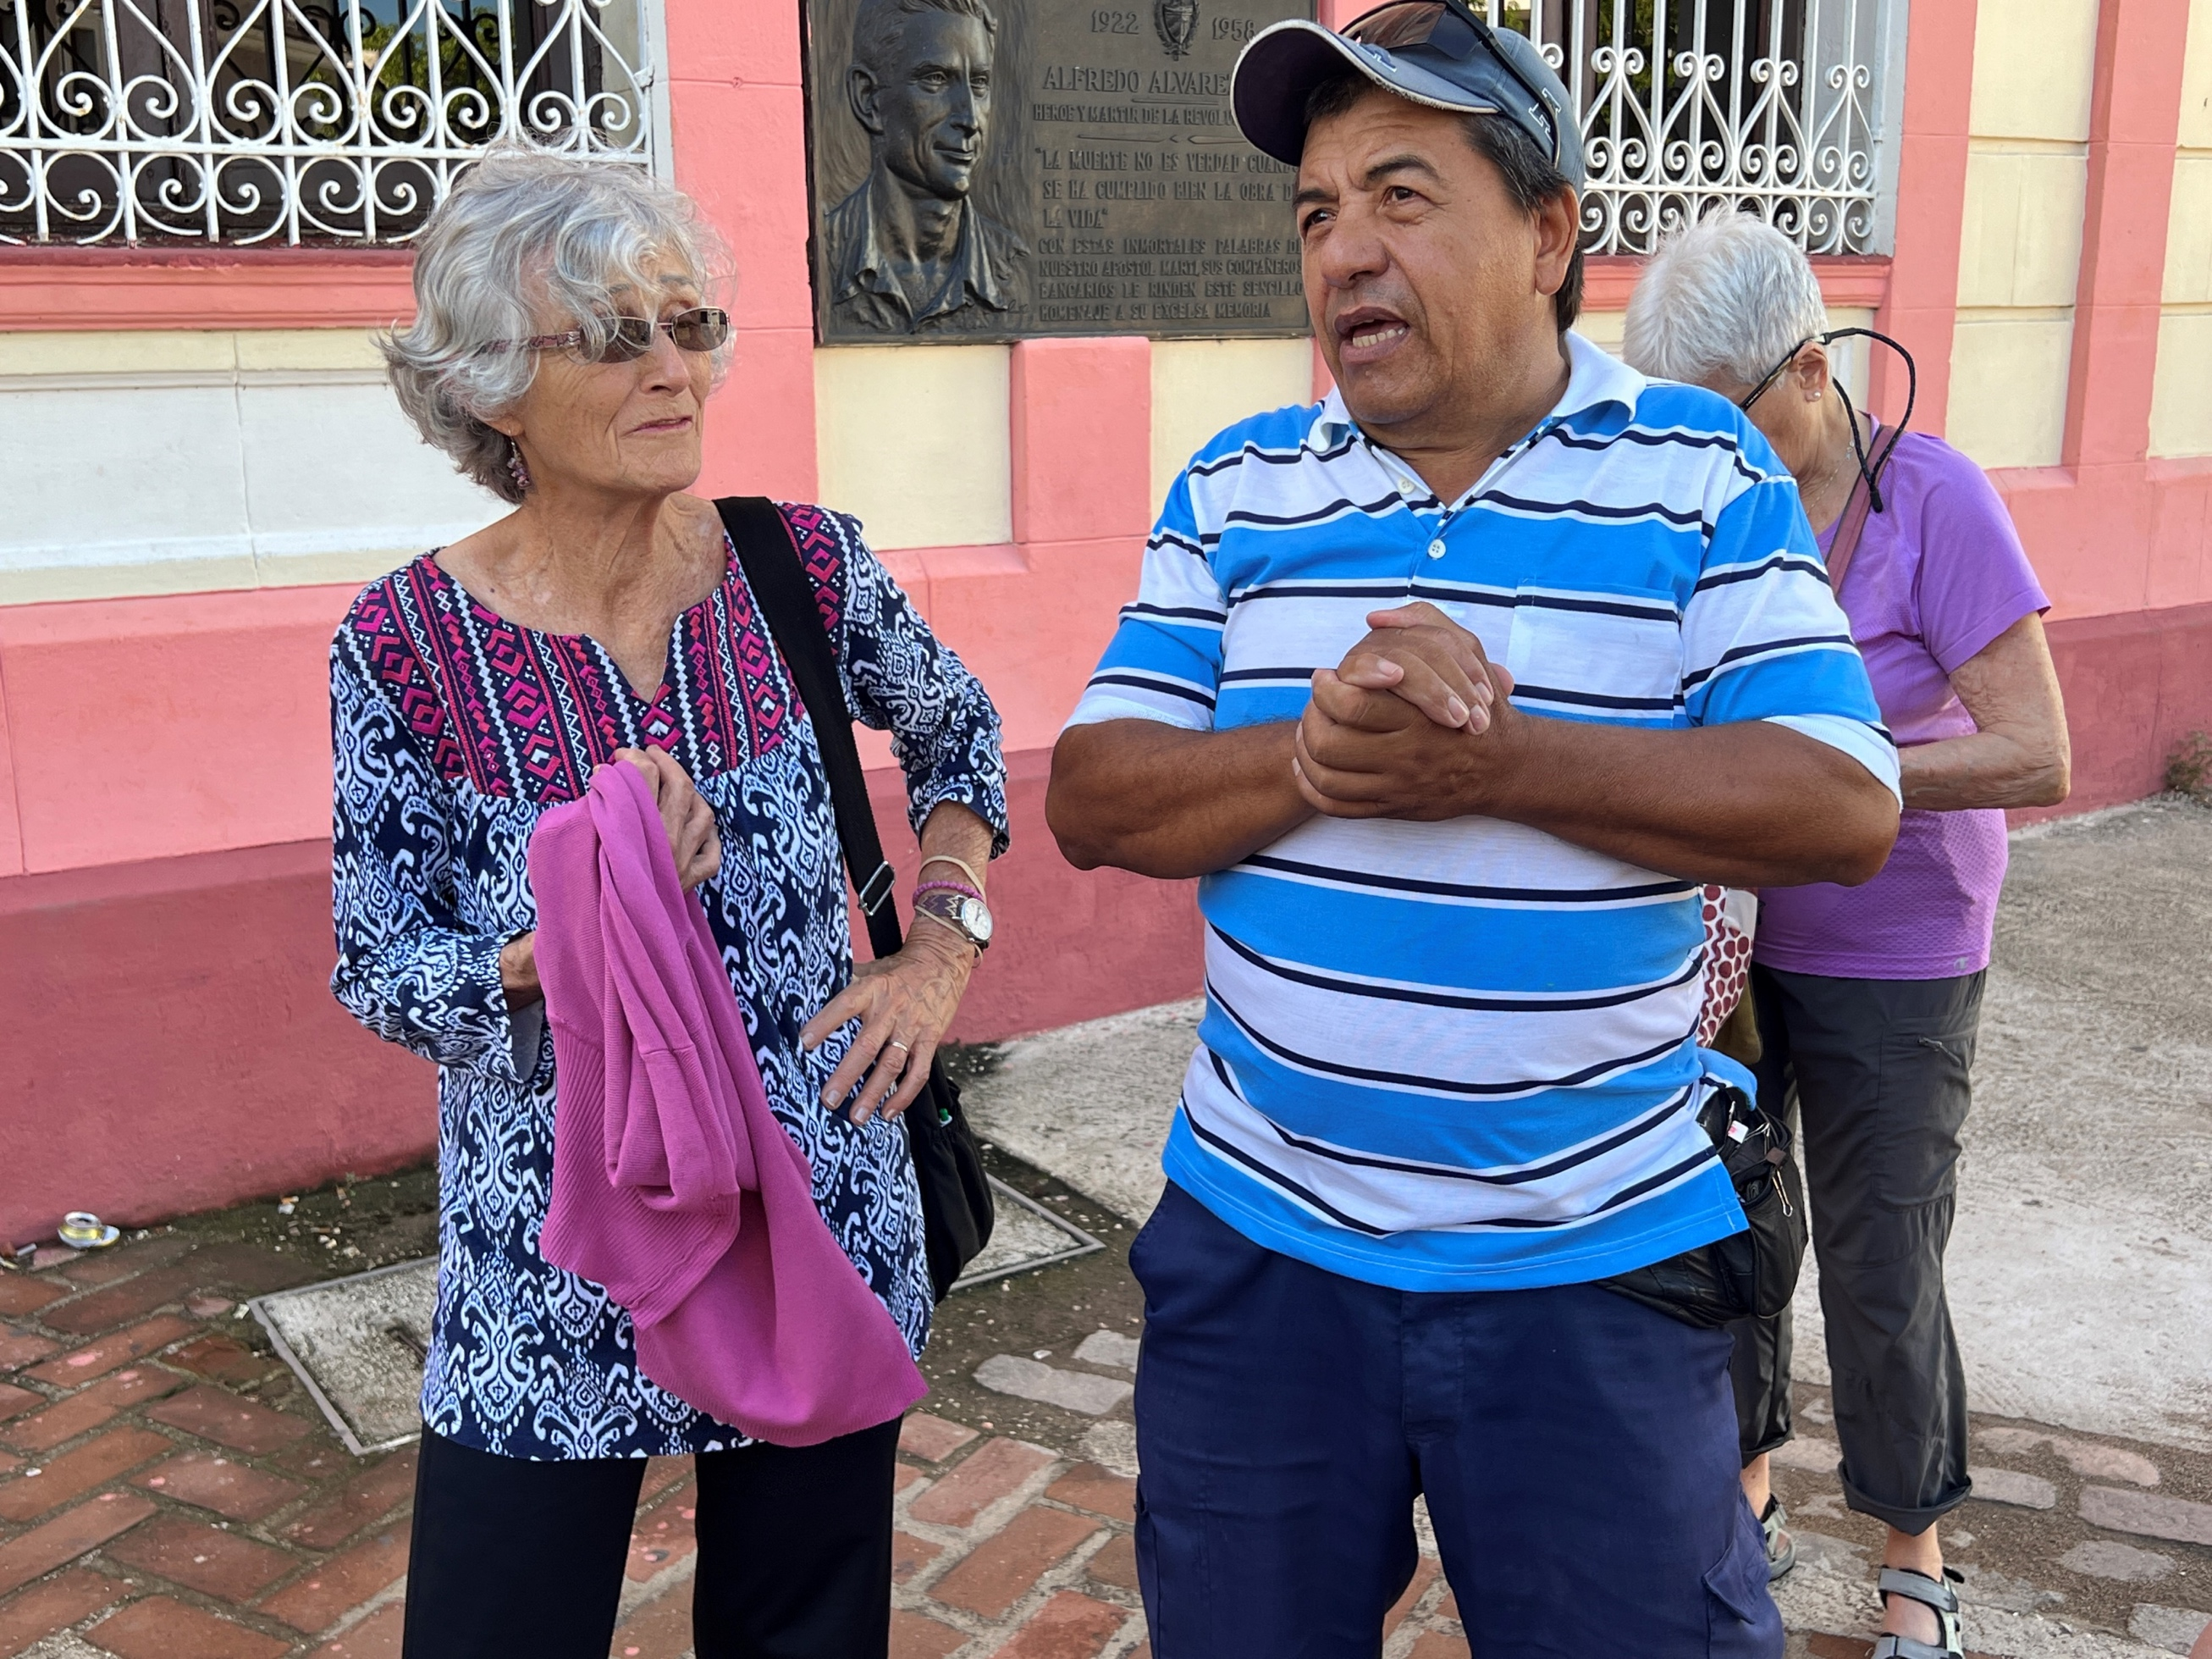
Alfredo Espinosa, the Director of “Andariegos”, a bici-taxi cooperative, is our guide, introducing us to the historic buildings on the plaza of Camagüey.

Slide 8
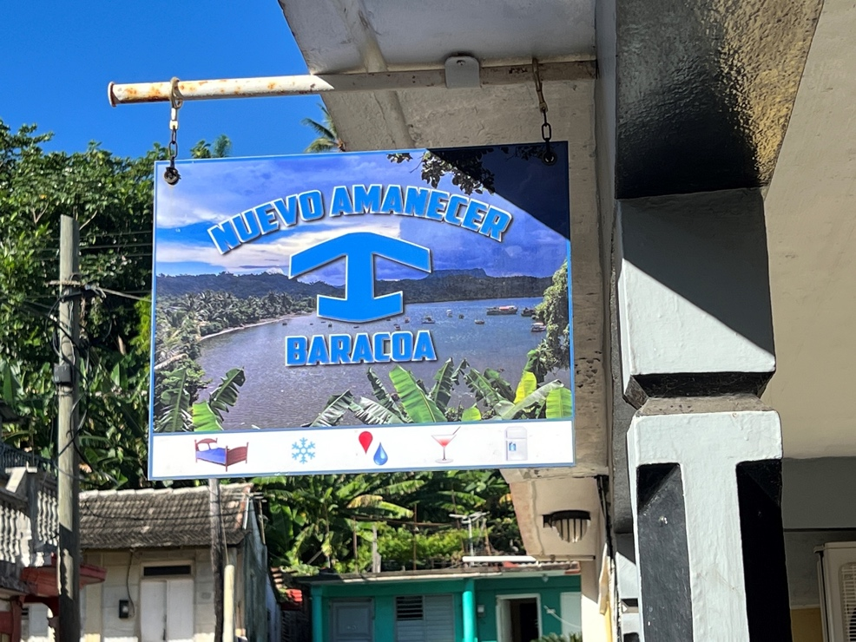
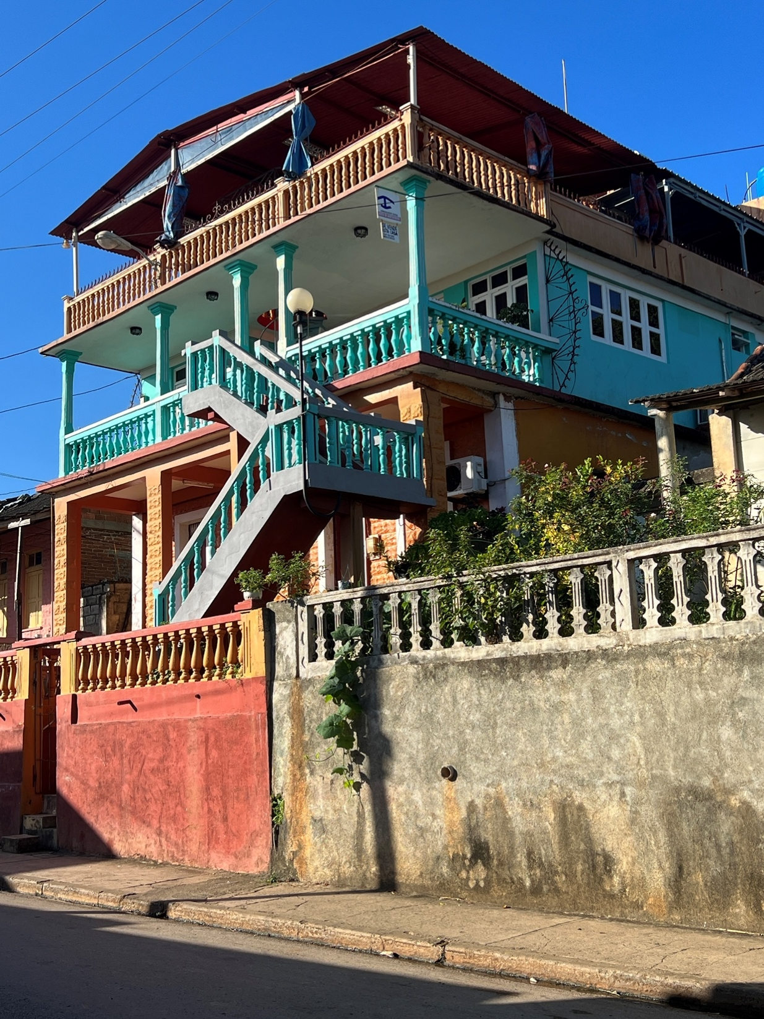
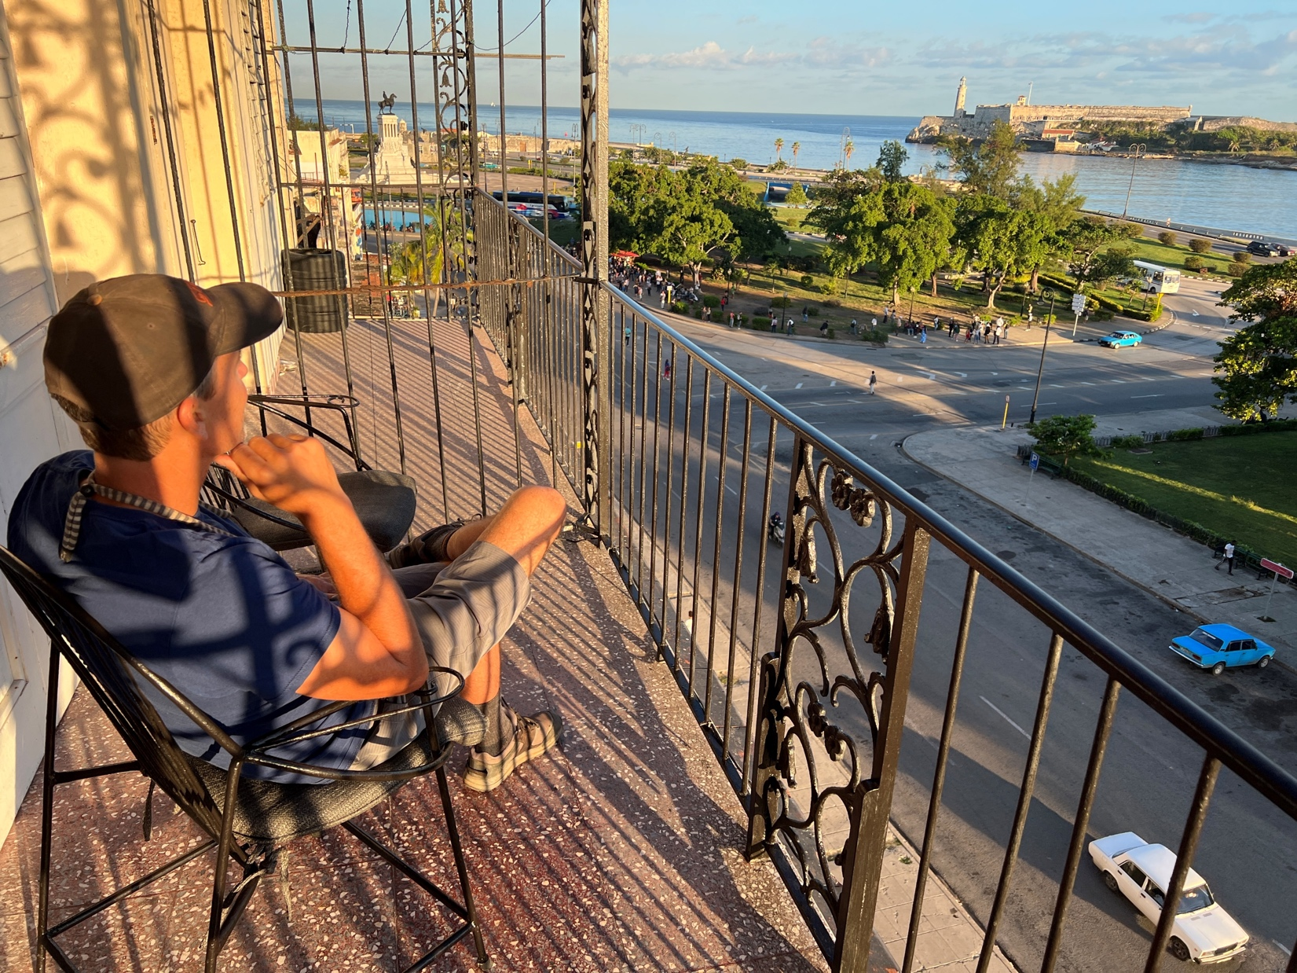
Lodging—we patronize private homestays
Baracoa
Havana

Slide 9
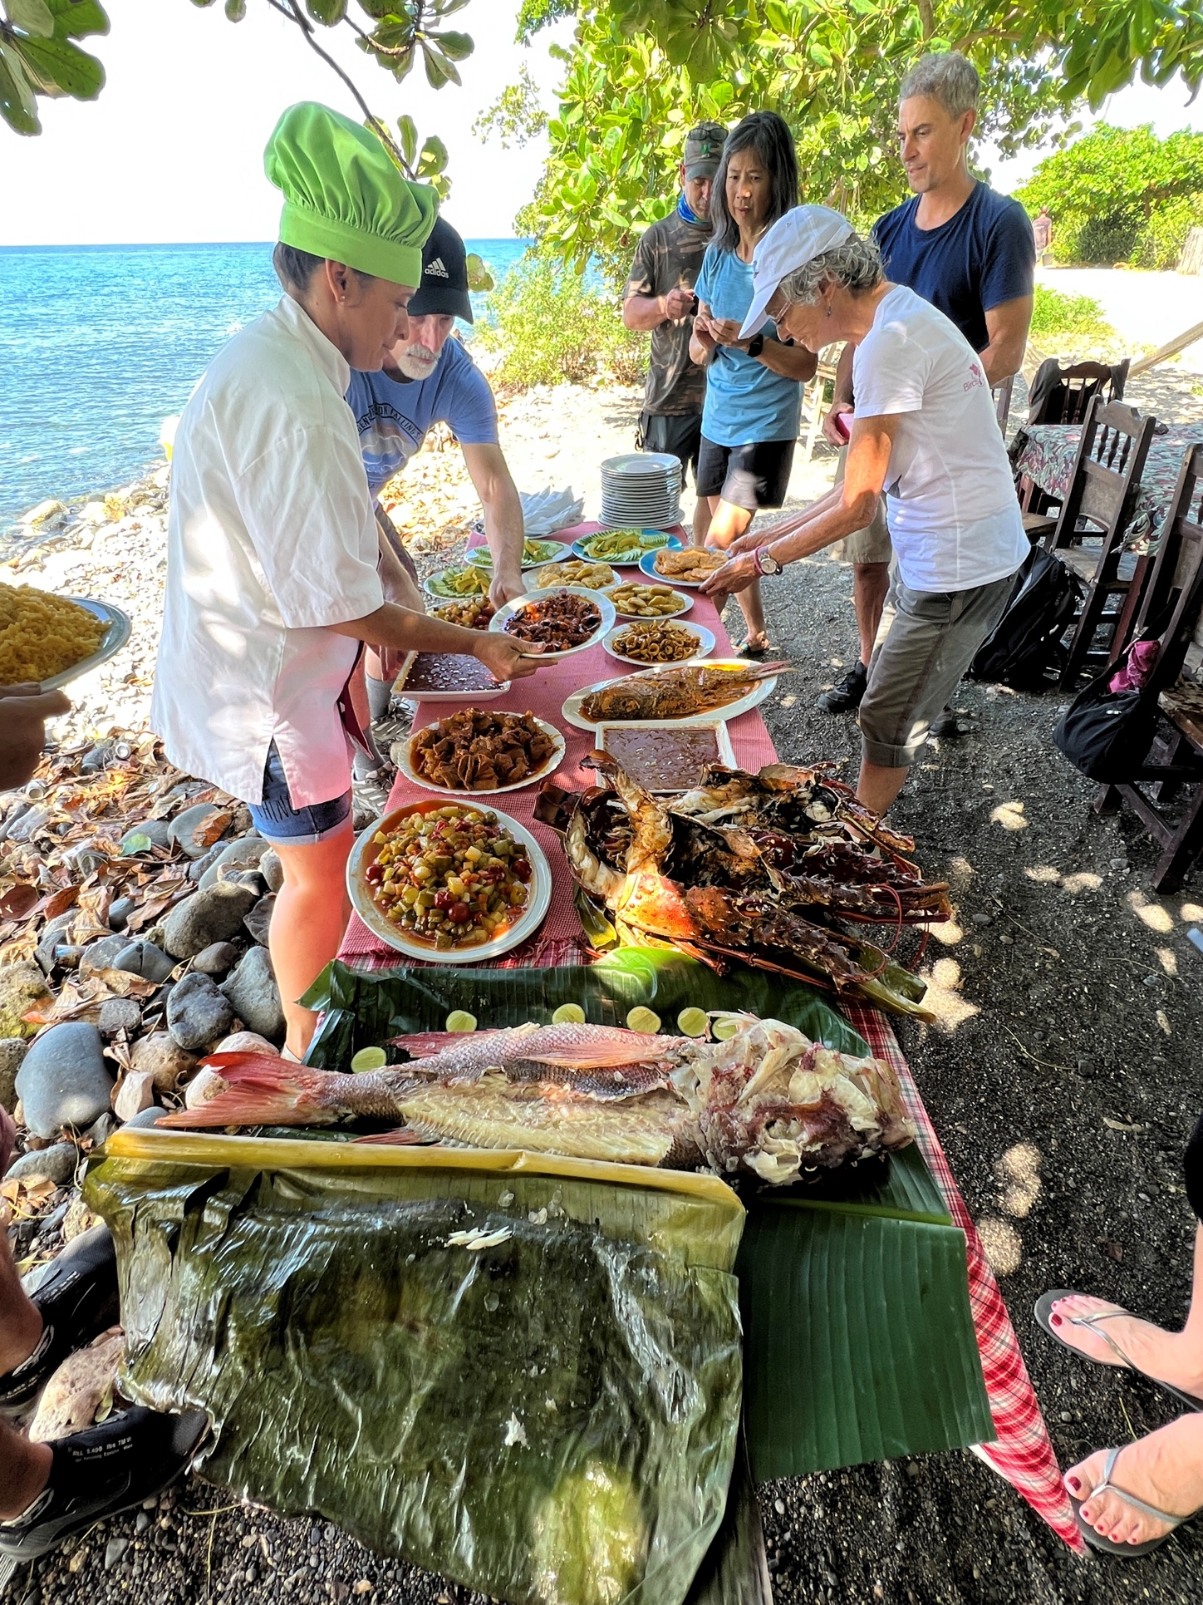
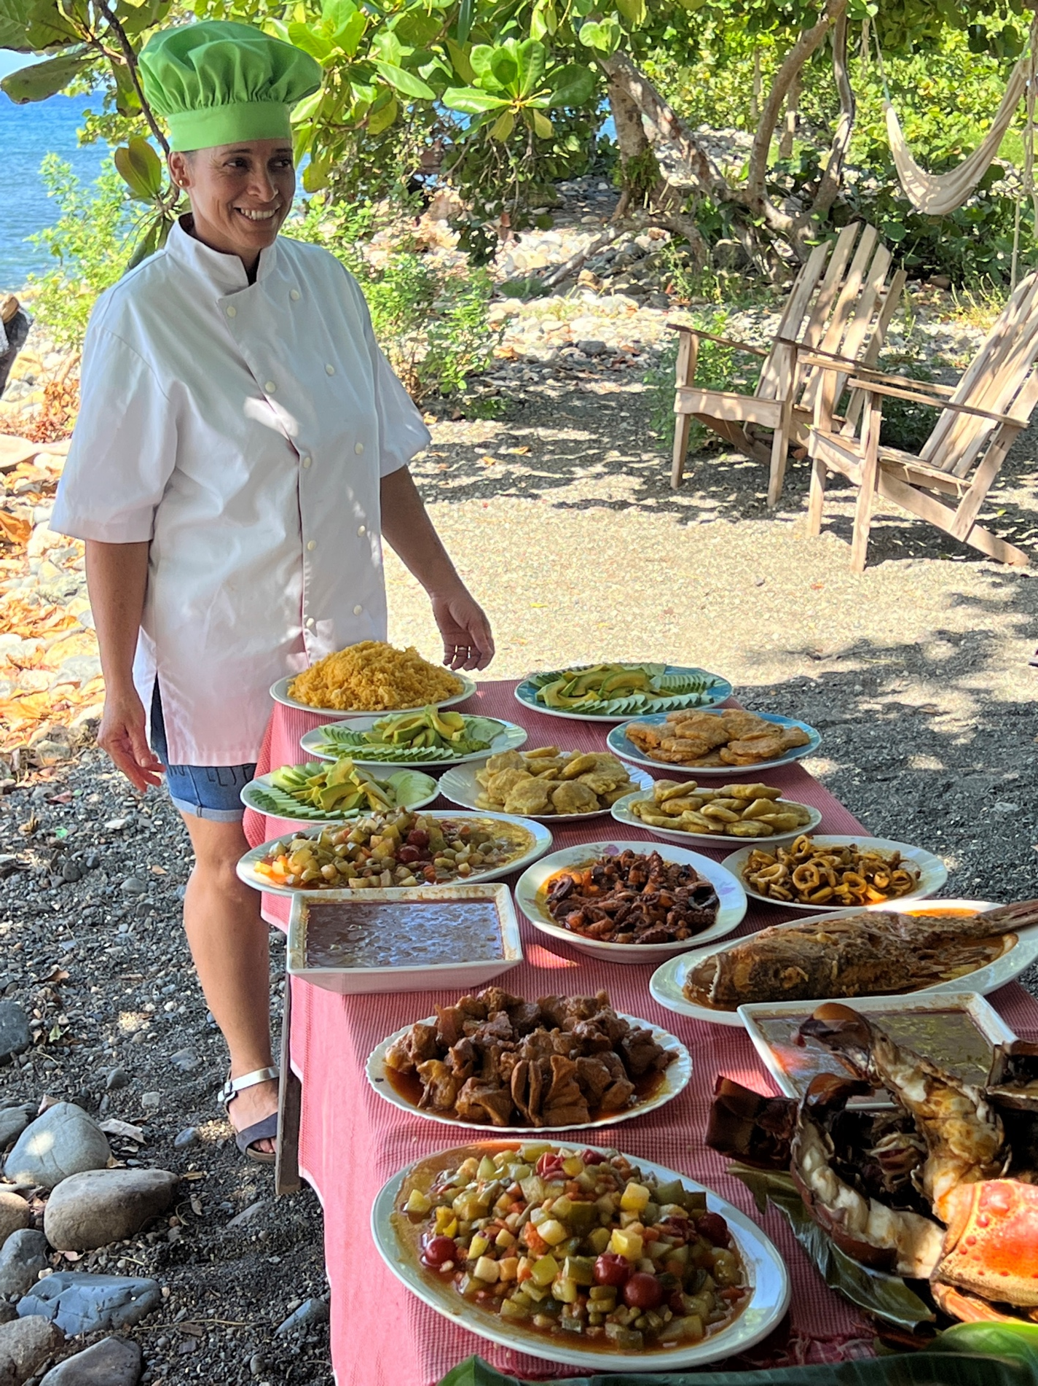
We patronize private restaurants
. . .and experience cuisine typical of the local culture…
…like this fantastic spread by Mirleidi in Yumurí!

Slide 10
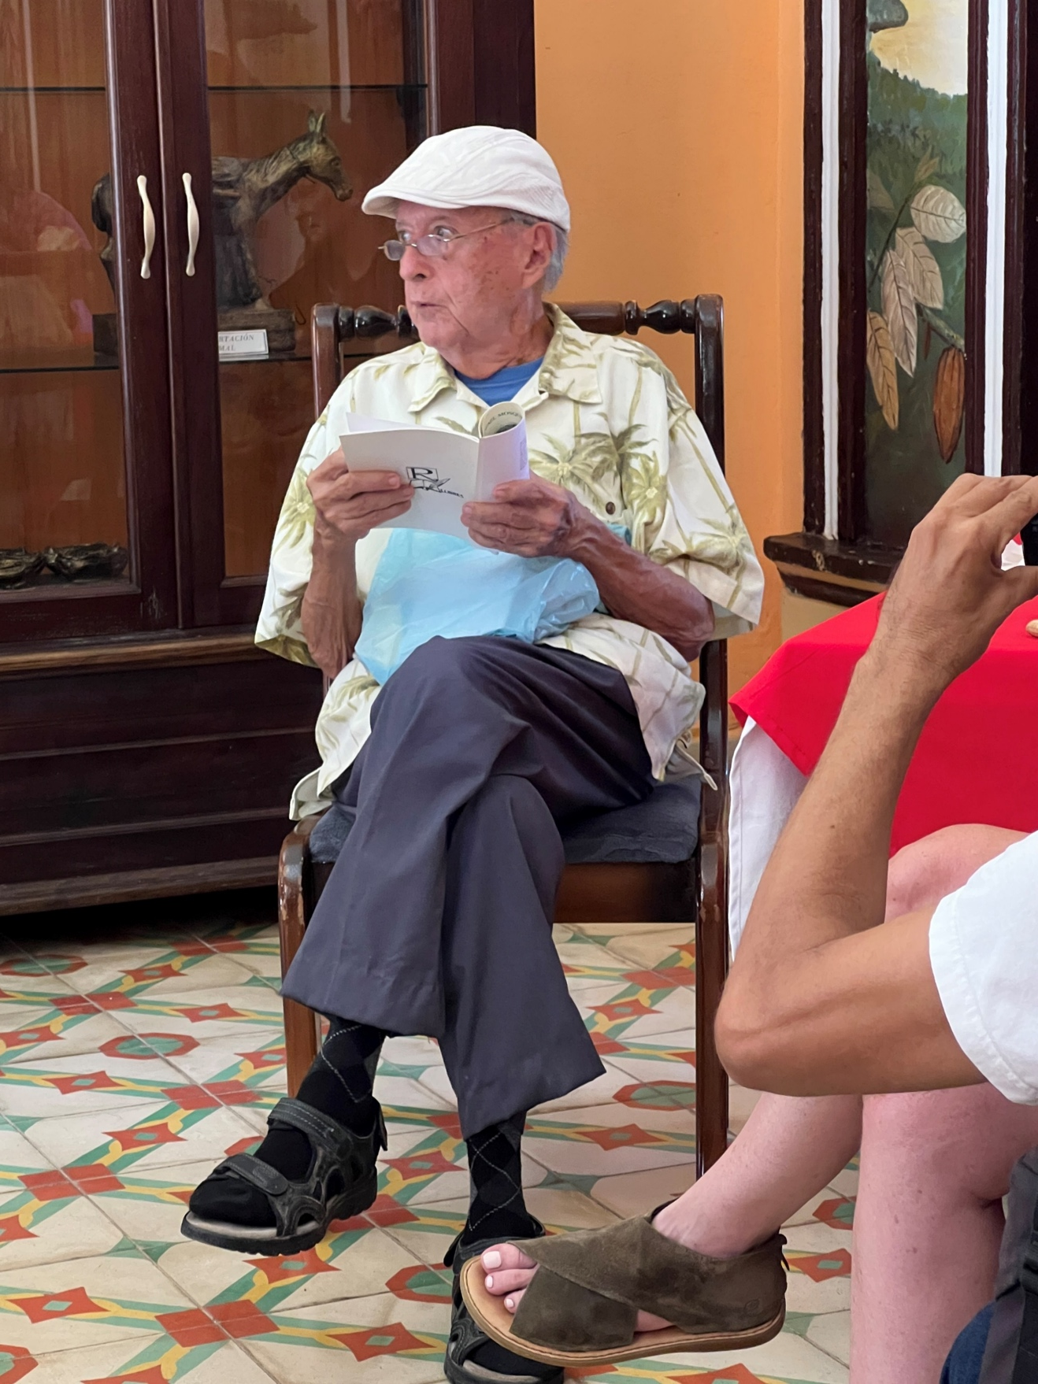
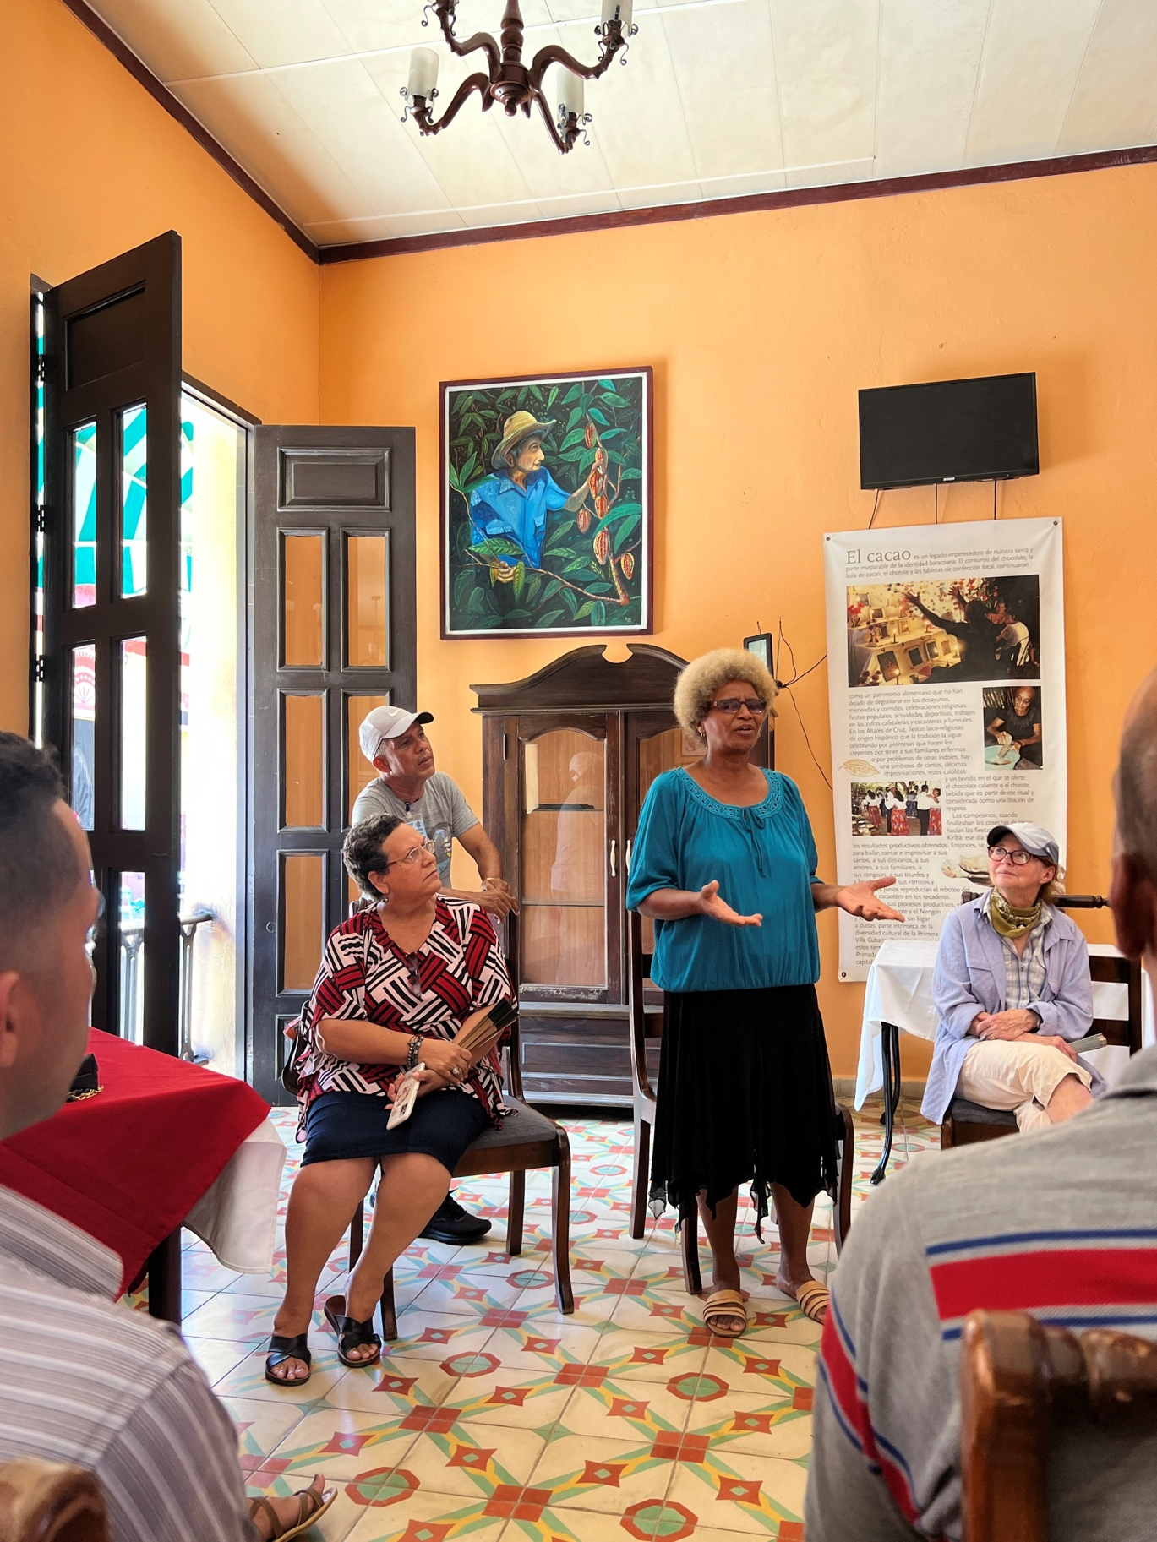
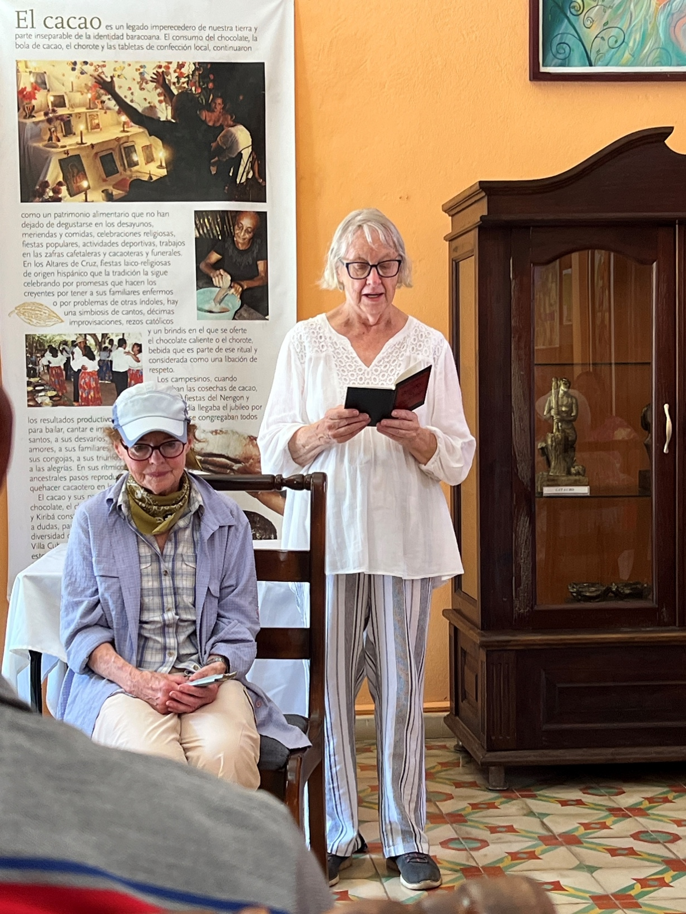
We engage in cultural exchanges such as poetry reading and presentations of books authored by Baracoans and edited and published by the Friendship Association.
Poetry Reading -- Baracoa
Sharyn Thompson, Friendship Association
Rafael Mosqueda, author Antes del Silencio
Gertrudís, Baracoan poet

Slide 11
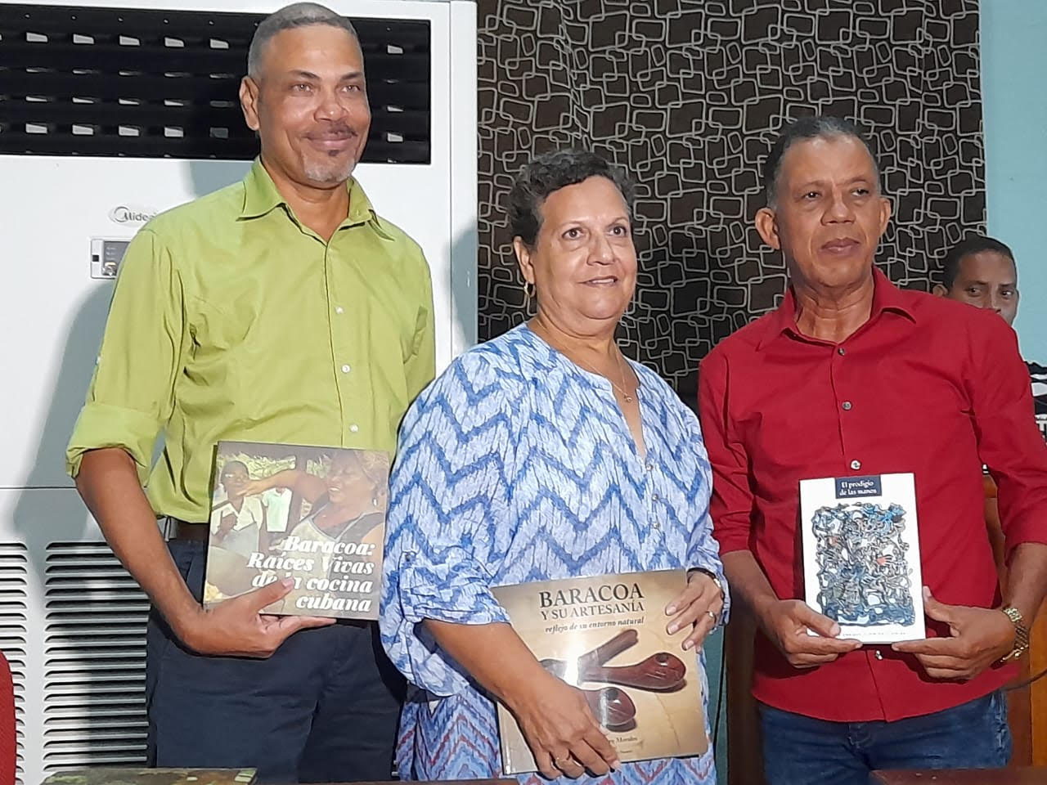
Baracoa authors: (R) José Enrique Floirián, El Prodigio de las Manos (The Prodigy of the Hands); (M) Noelvis Pérez, Baracoa y su Artesanía: Reflejo de su entorno natural (Baracoa and its Crafts: Reflection of its natural environment);
(L) Javier Lafita, Baracoa: Raíces Vivas de la Cocina Cubana (Baracoa: Living Roots of Cuban Cuisine)

Slide 12
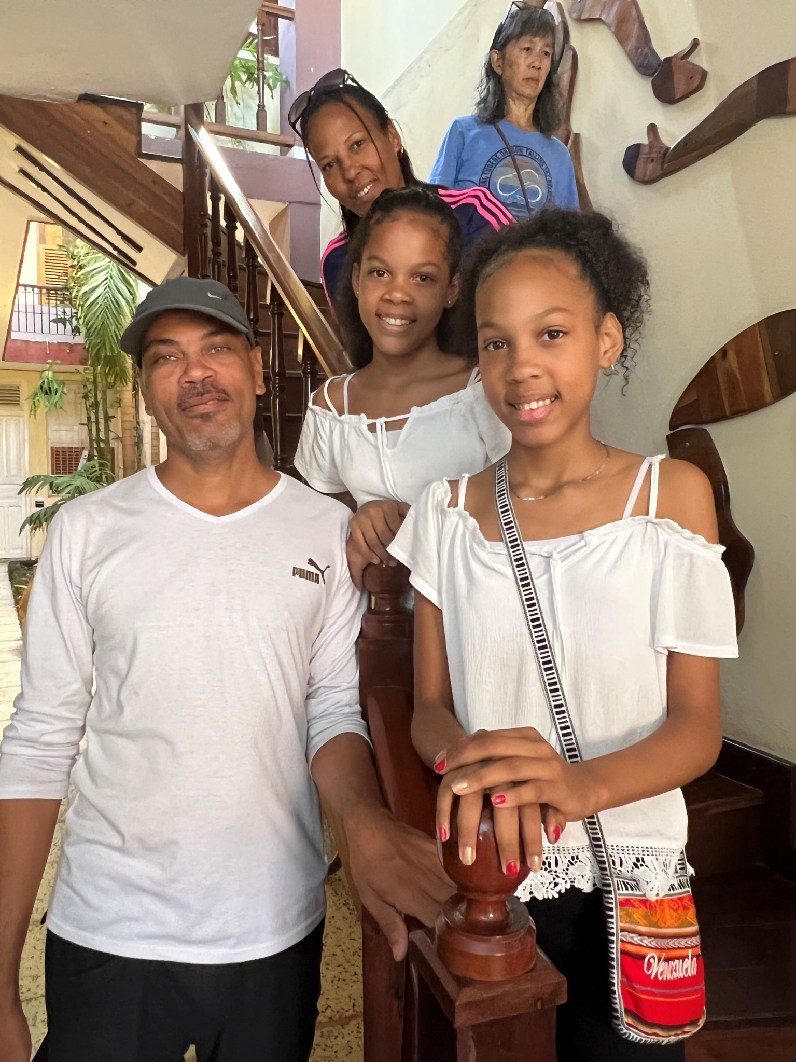
Author Javier Lafita and family. They live in Havana but due to COVID and costs, had not been able to visit their extended family in Baracoa for about 4 years. The Friendship Association bus carried them with us to Baracoa, where they spent a few days visiting their relatives, and then returned with us to Havana.

Slide 13
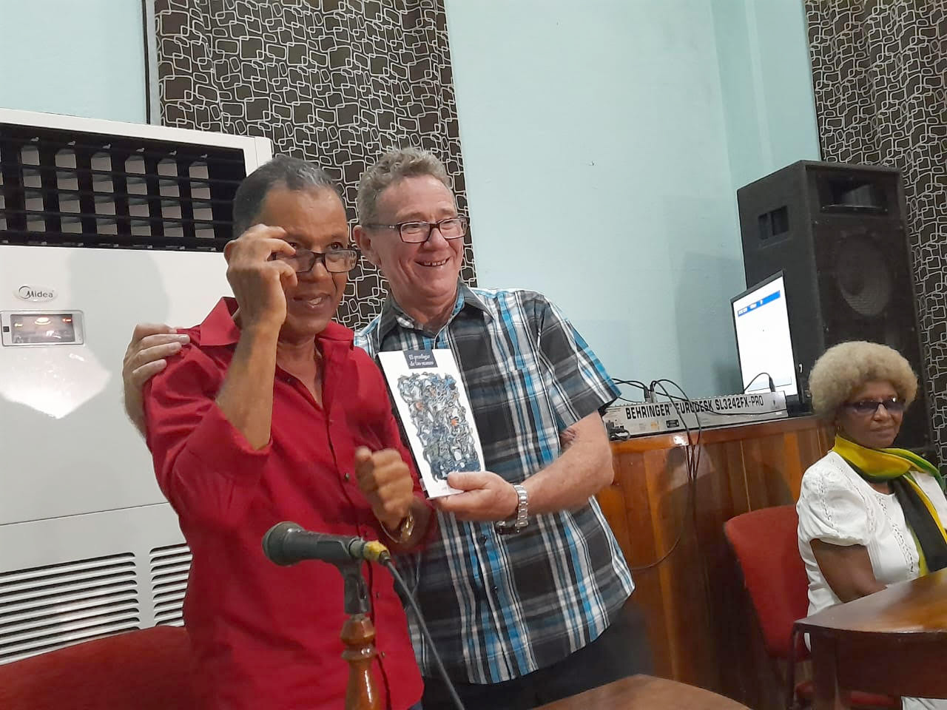
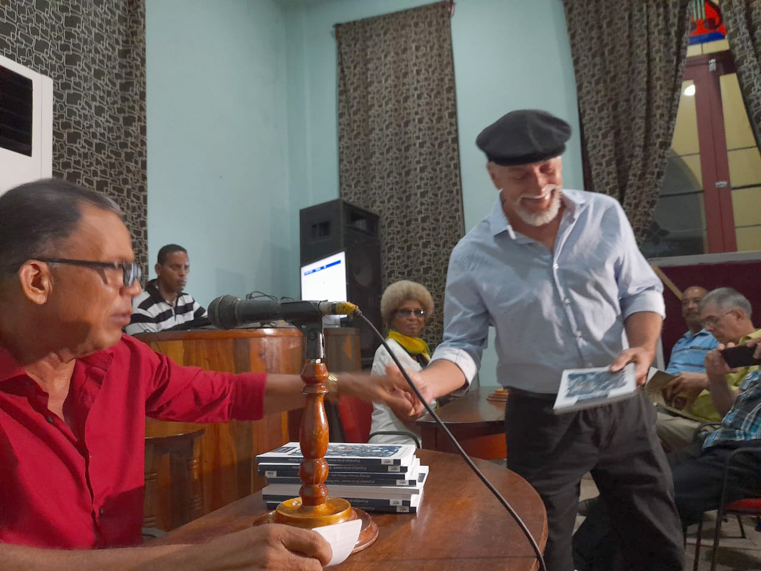
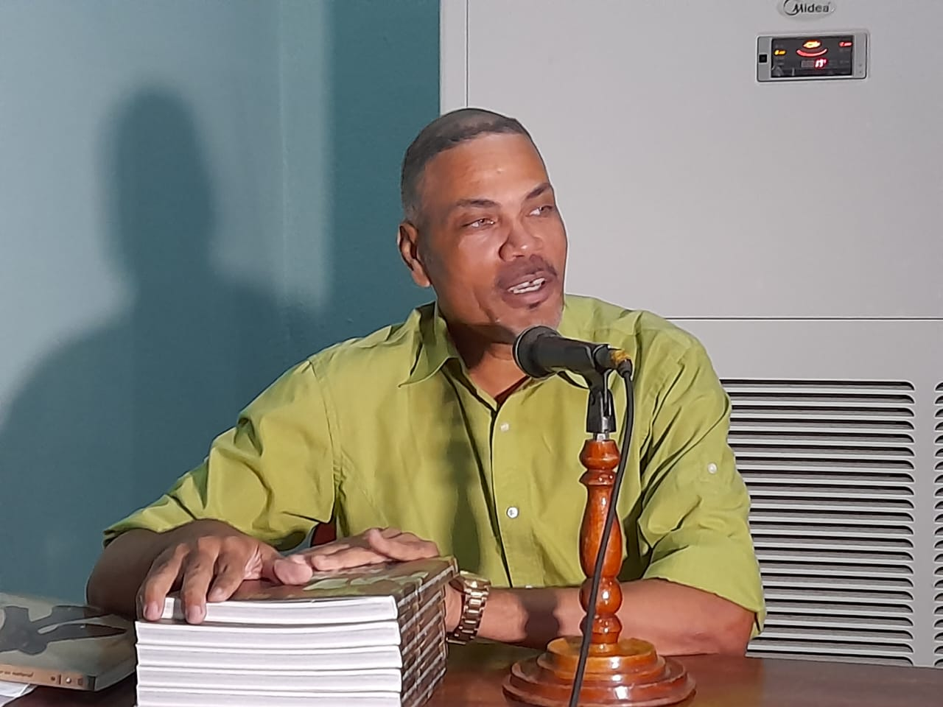
The preceding three authors were featured at their book presentations, which we attended. Book publishing by Cuban authors is an important part of the work of the Friendship Association, under the publishing name of Ediciones Nuevos Mundos. Soledad Pagliuca, Kate Hennessey and Sharyn Thompson work closely with the authors as they edit and translate their work.

Slide 14
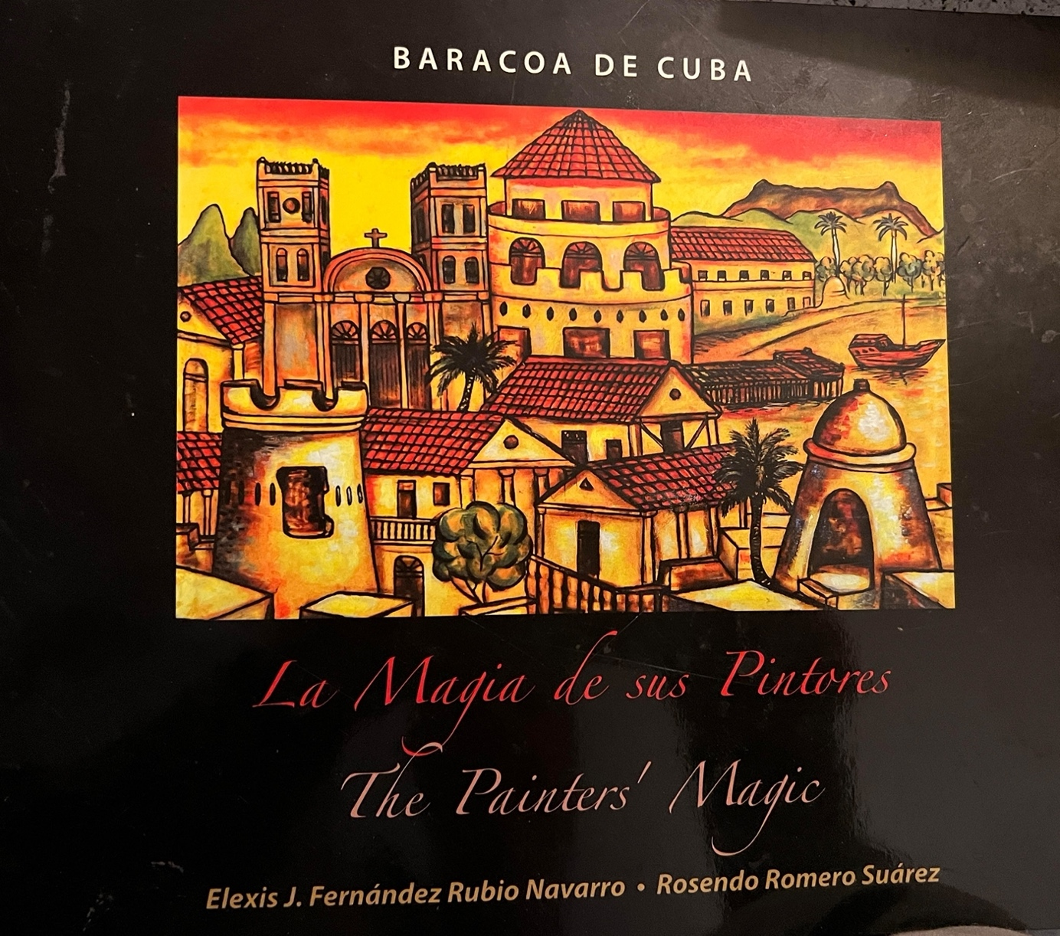
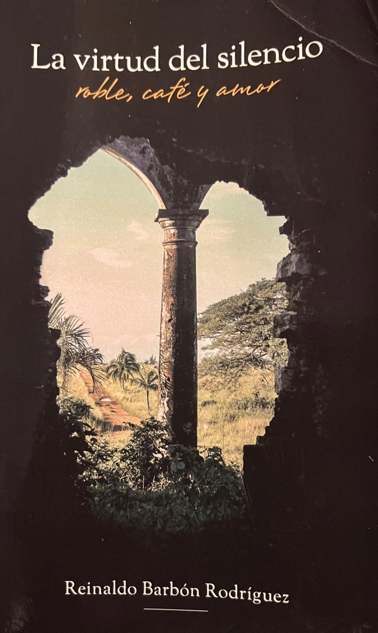
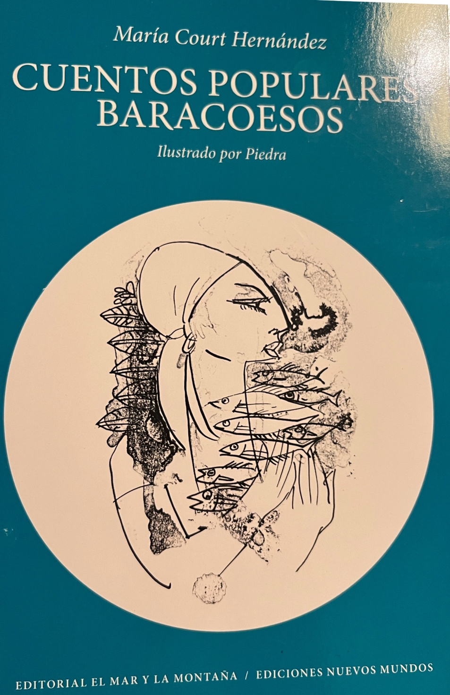
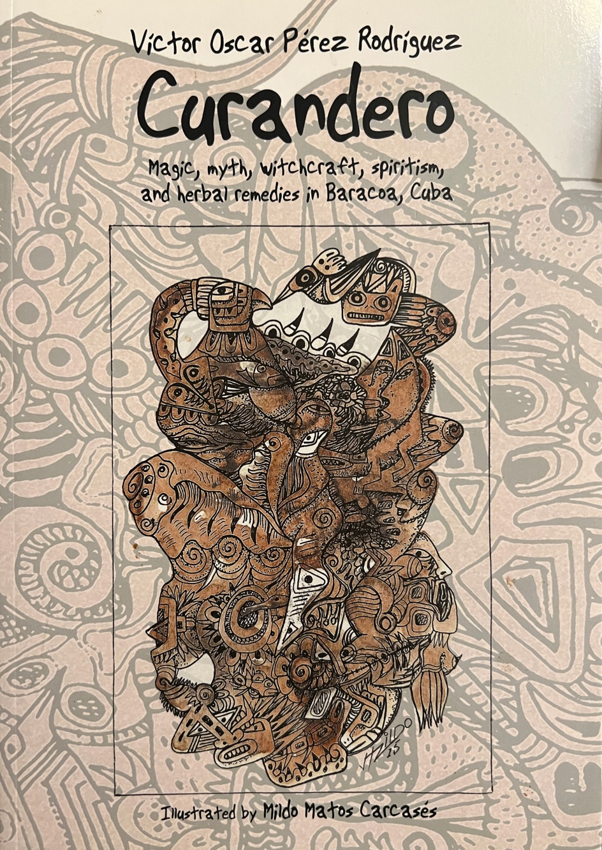
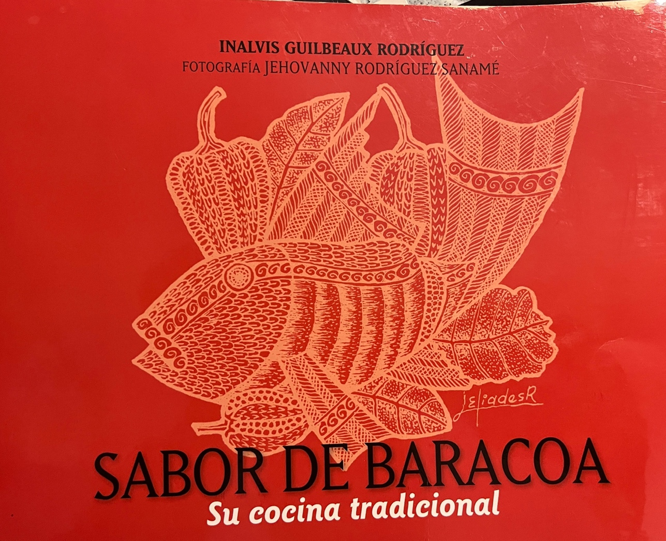
A portion of the books published by the Friendship Association in collaboration with our Cuban writers and friends.

Slide 15
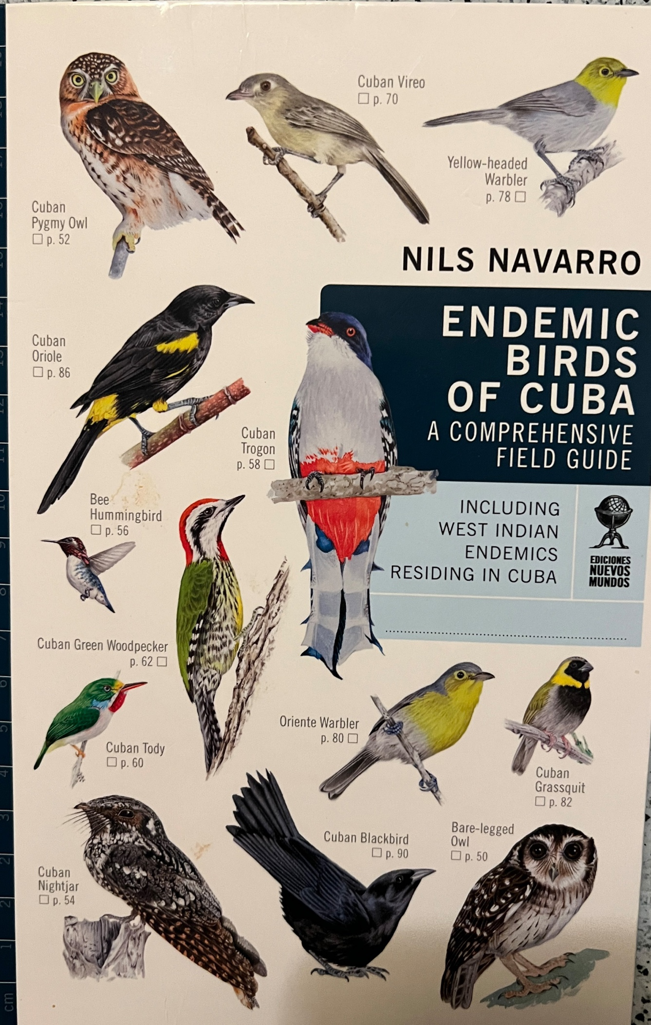
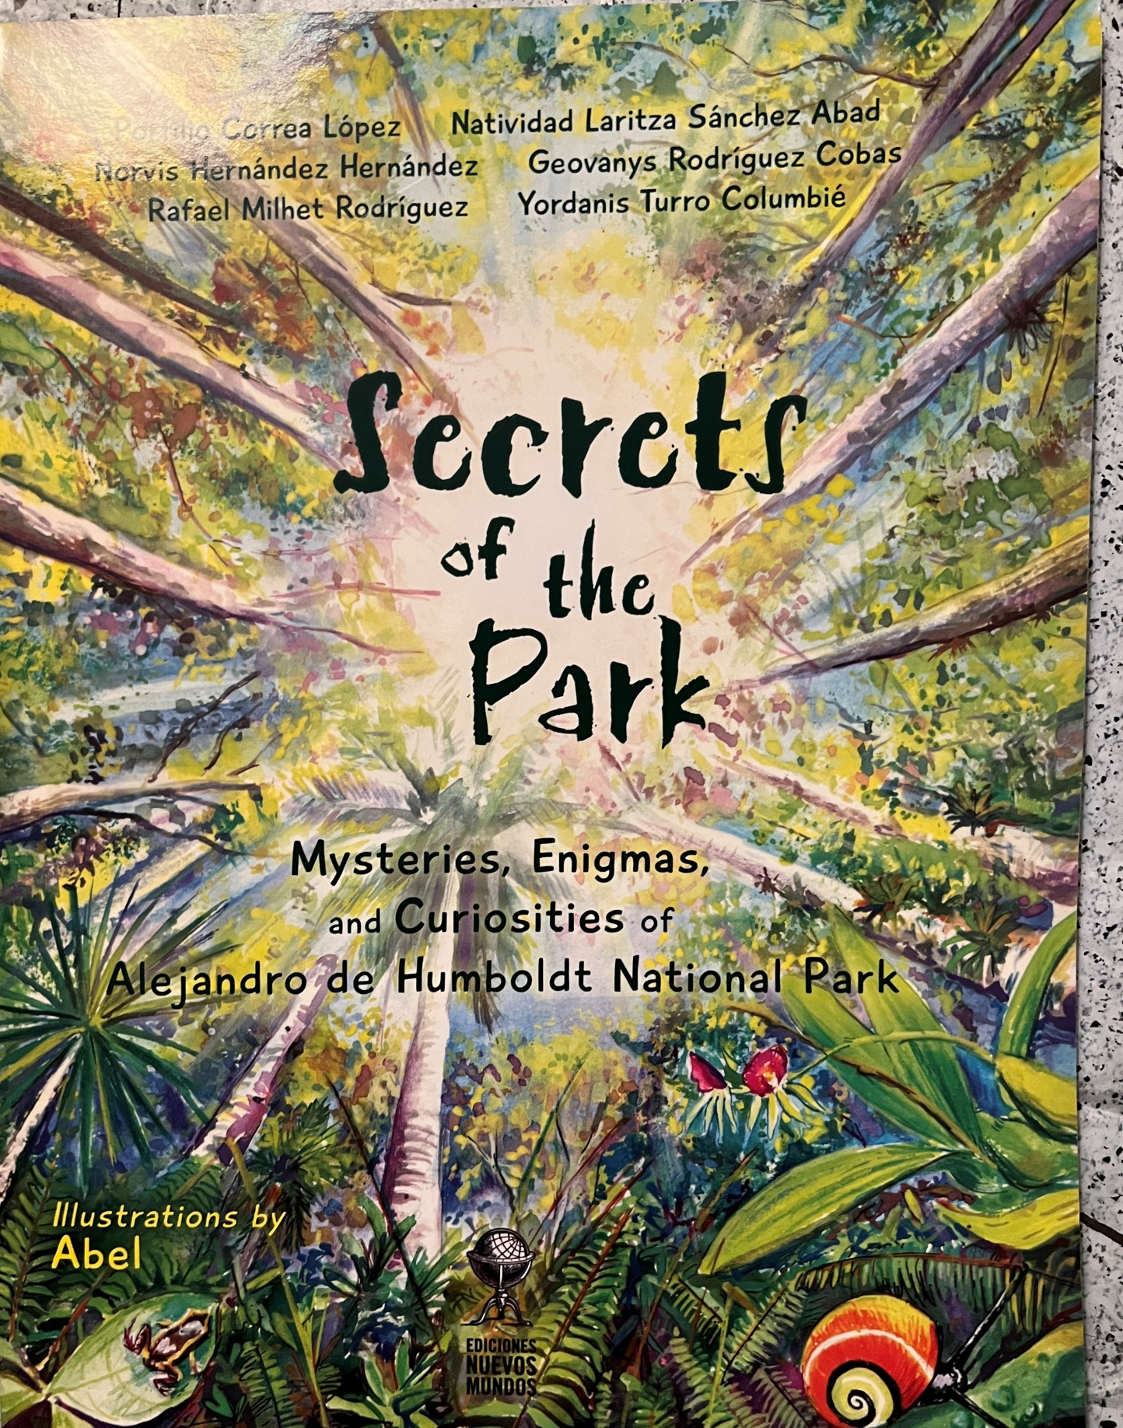

Slide 16
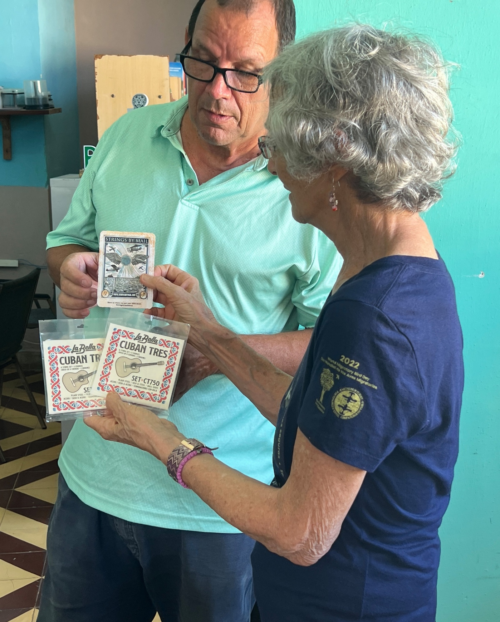
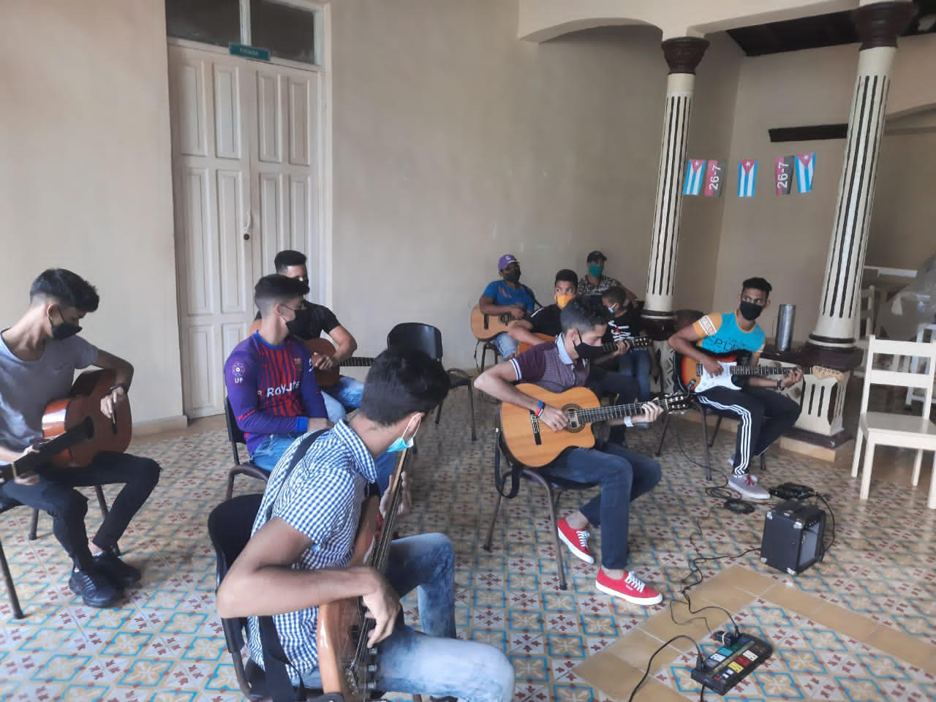
In addition to authors, the Friendship Association also supports local artists and musicians by donating much needed supplies which are difficult to obtain in Cuba: paints, canvass, brushes, guitar strings and other musical paraphernalia. Friendship Association members can often be counted on to purchase unique paintings from the artists to take home for their walls.
“Cuchito”, the founder of the music project “Alejandro”, which
is a participatory workshop based in the Baracoa library.
Soledad is showing him hard to find Cuban Tres strings she found at Strings by Mail in the U.S

Slide 17
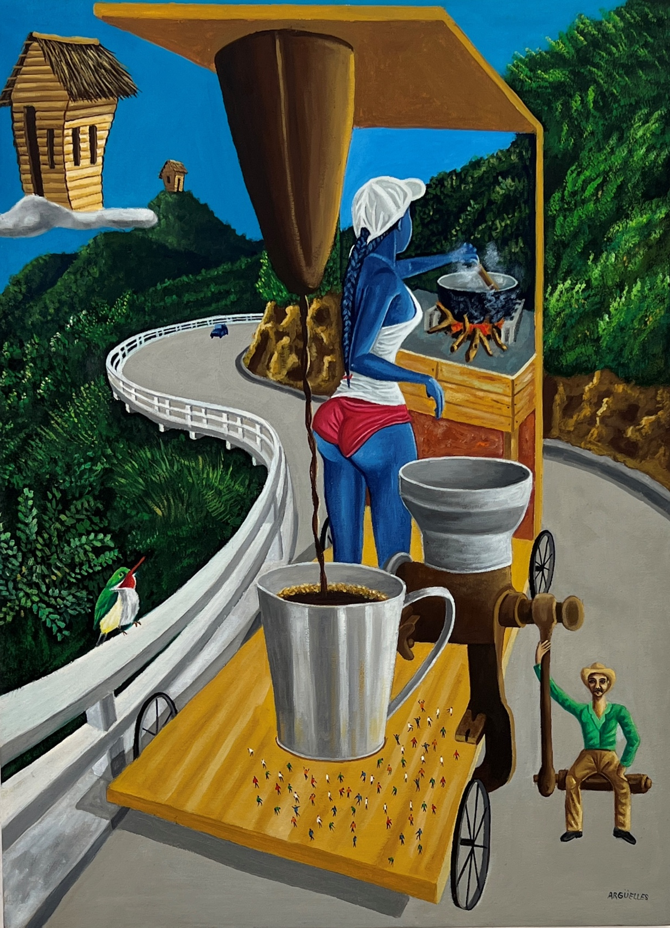
Baracoan artists display their work in the Galería de Arte and la Casa de Cultura.

Slide 18
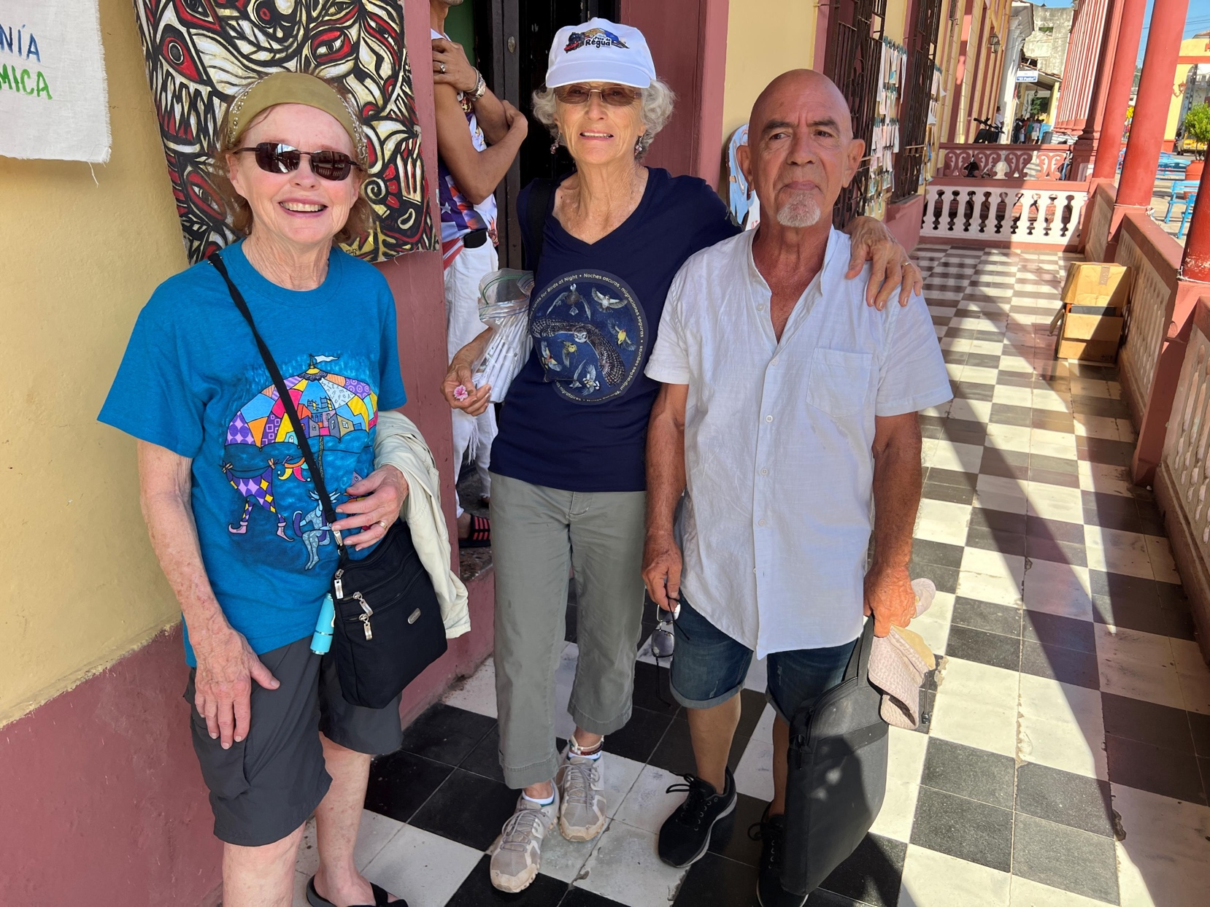
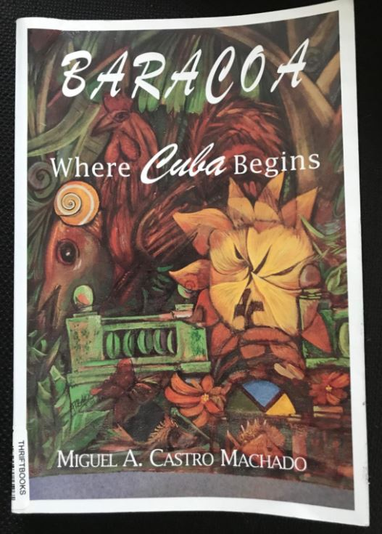
Miguel A. Castro Machado
with Kate and Soledad.
Miguel Castro is an award winning screenwriter and director. He won first prize in the category of oral history in the National Radio Festival for his program, “La Cruz de la Parra (The Cross of Parra)”.
Prof Castro’s articles, essays and poetry about Baracoa appear in national and international publications and guidebooks in Cuba.

Slide 19
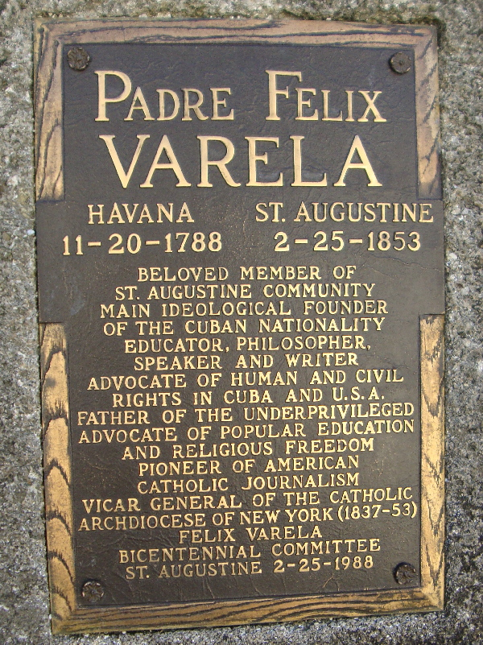
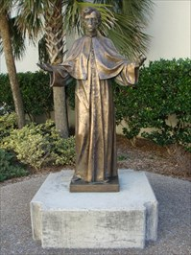
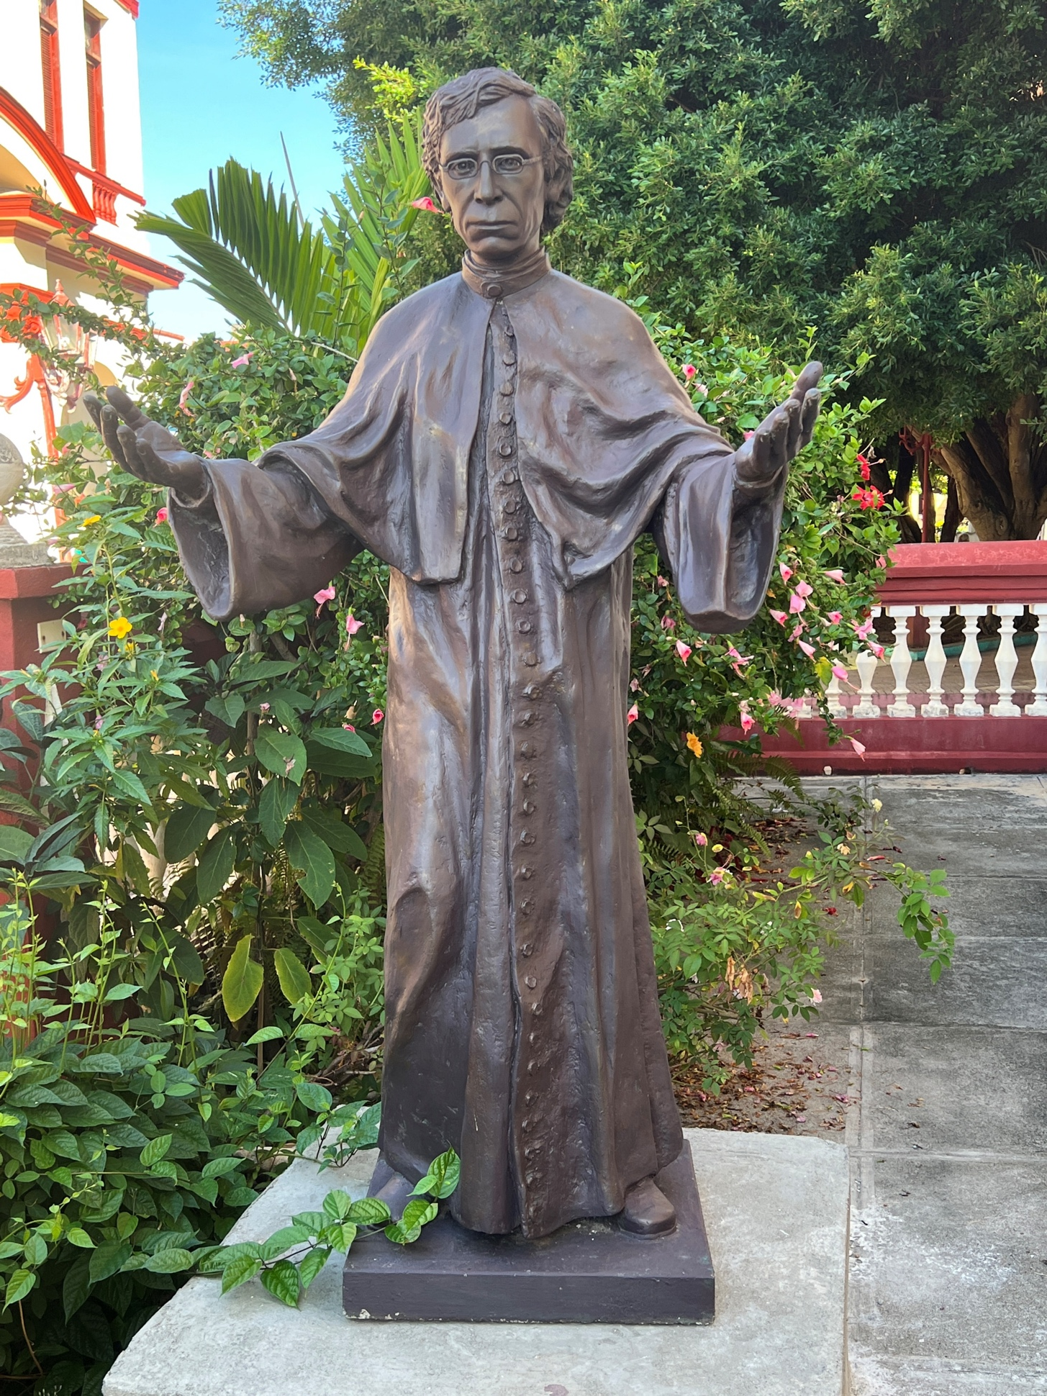
Soledad sent a photo of a statue of Father Varela in St. Augustine (above), to Cuban artist Abel, who then sculpted the priest (on the left) and placed it on the grounds of the Catholic church in Baracoa

Slide 20
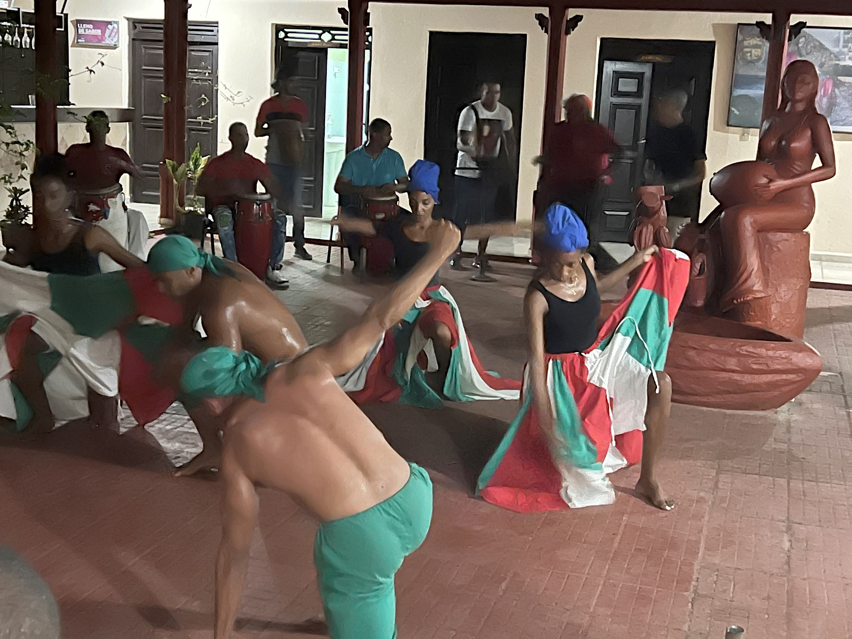
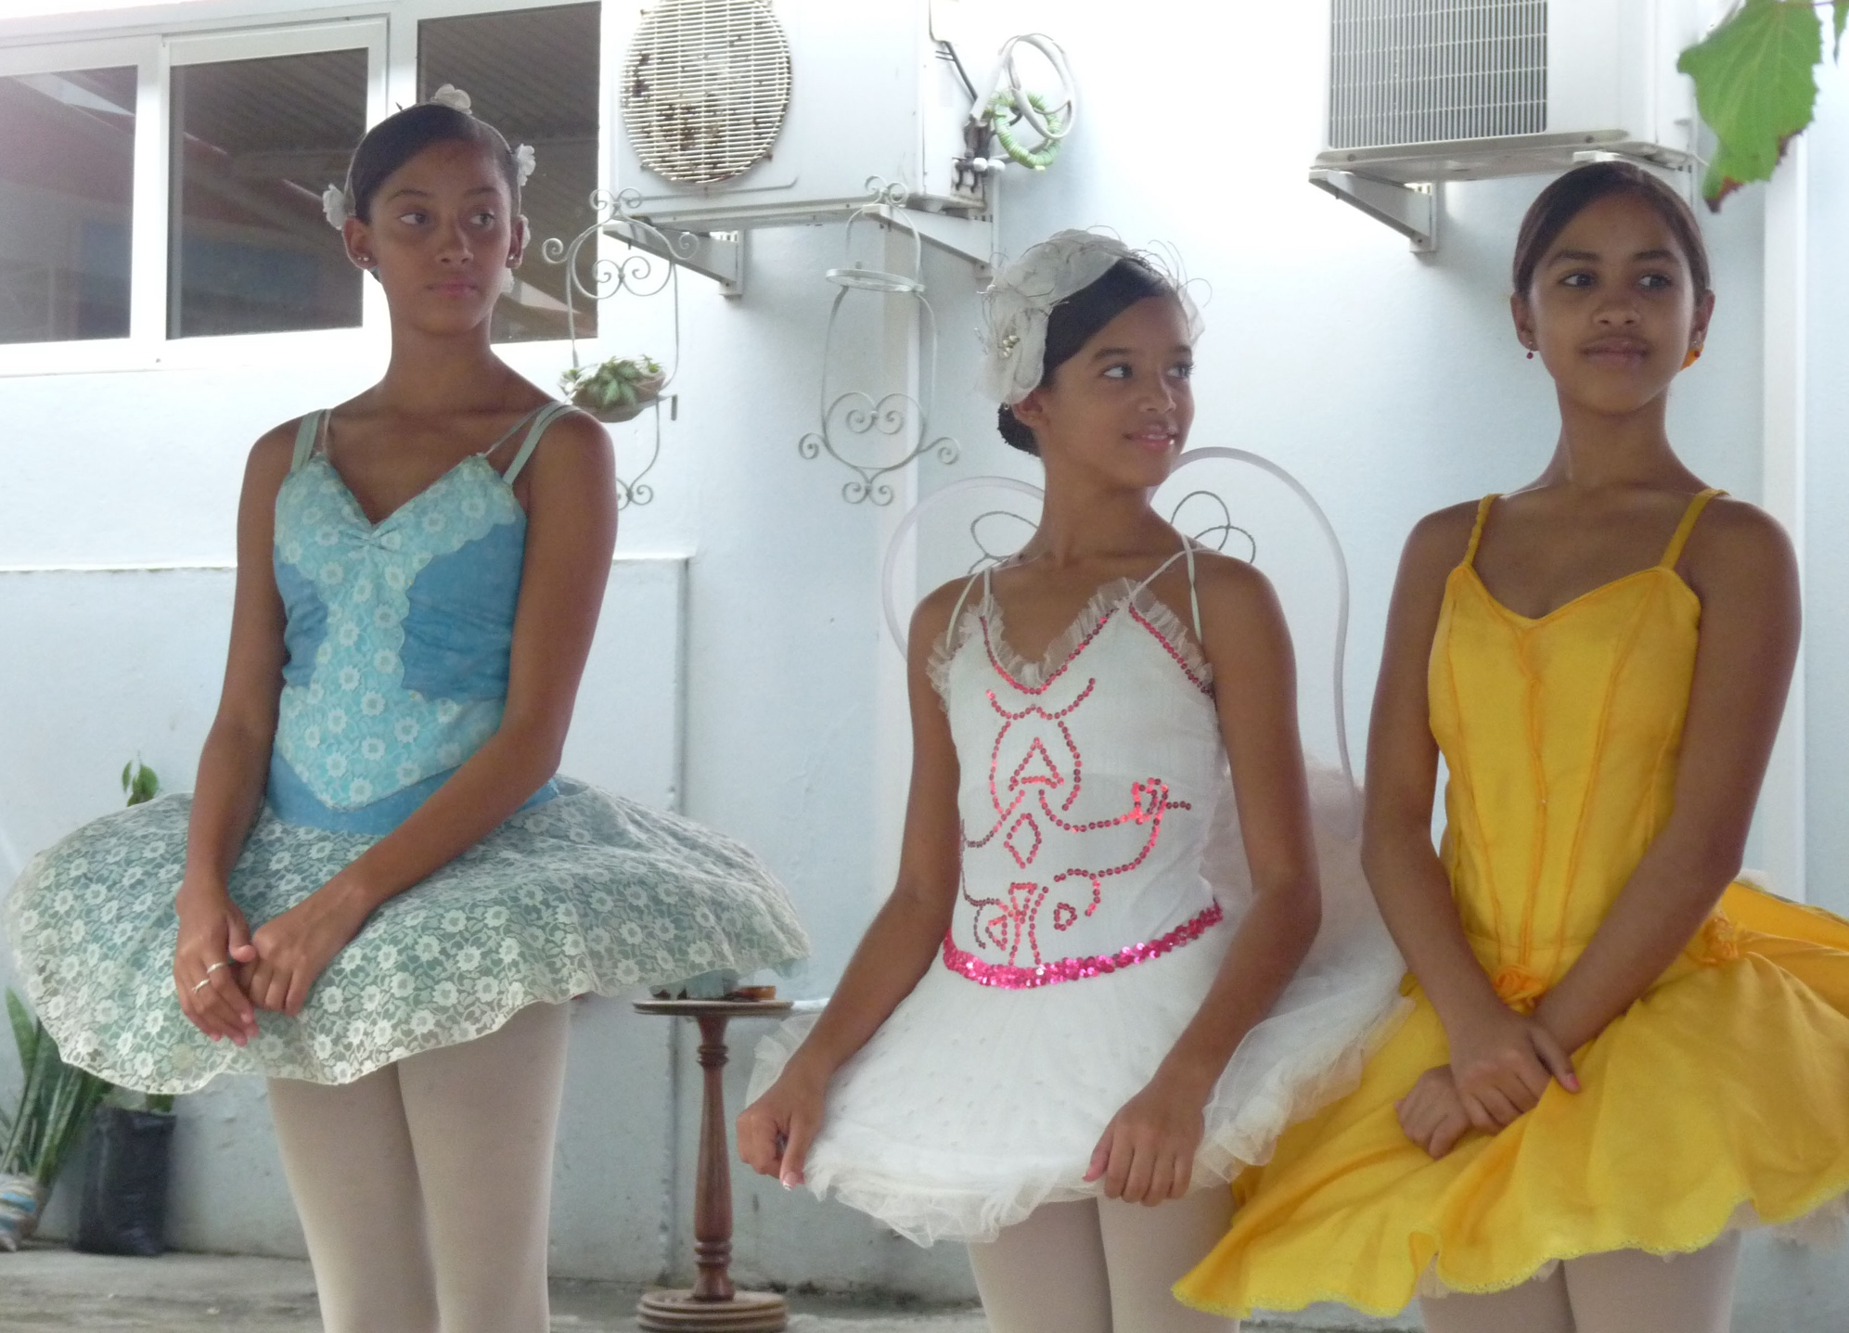
The Friendship Association has donated fabric for the Guantánamo School of Ballet.
The Bararumba Troupe of Baracoa performed especially for our group, demonstrating Afro-Cuban Folkloric Percussionist/Dance and Song .

Slide 21
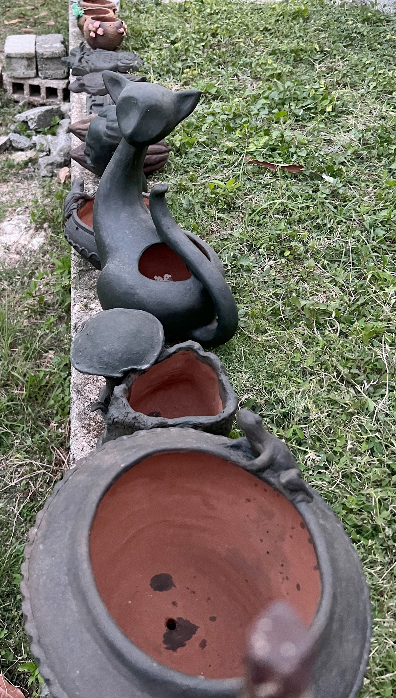
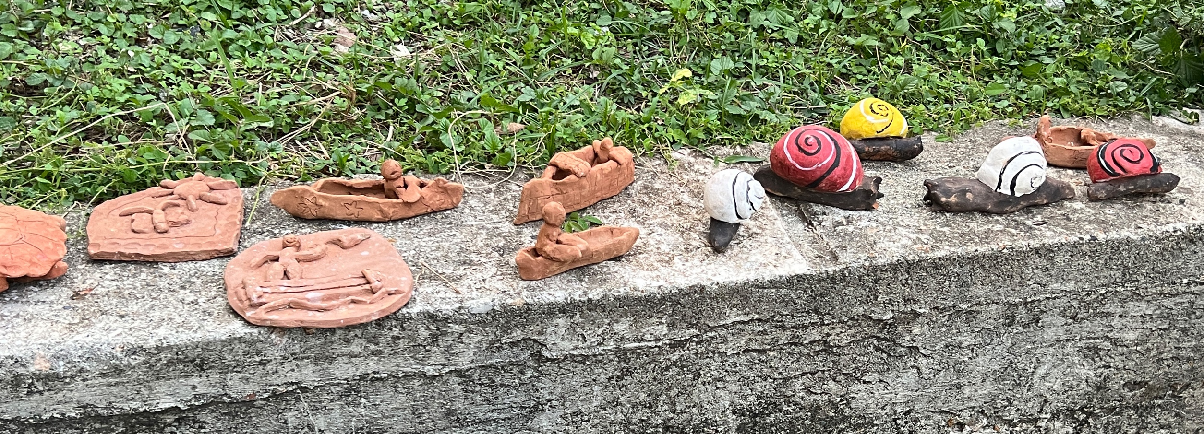
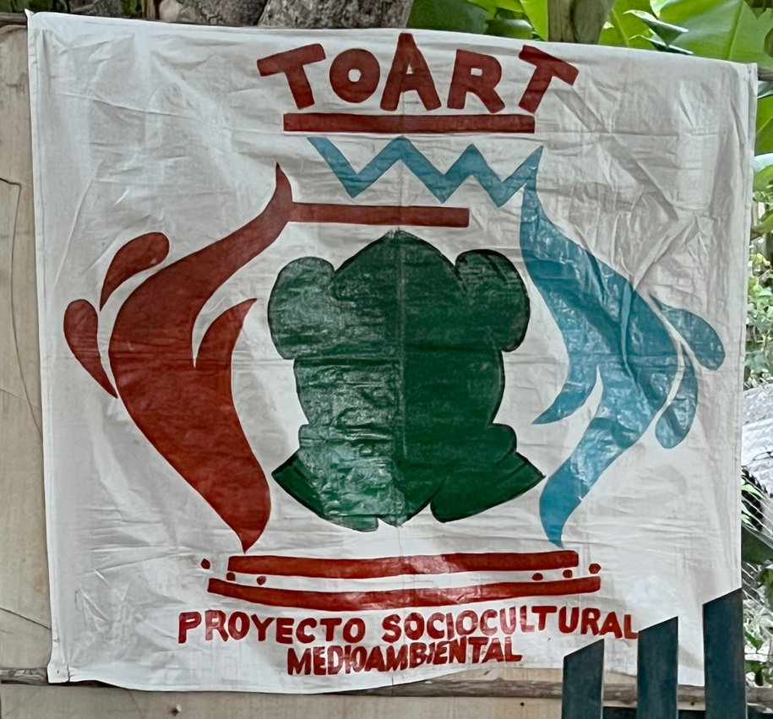
Creations by children
The Friendship Association supports the organization TOART, to which they have donated educational materials and materials for making pottery. TOART is an organization which provides education about the environment through the creation of pottery to kids in various rural communities. Georgia Henkel, a Friendship Association member, taught a workshop here during the time we were in Baracoa.

Slide 22
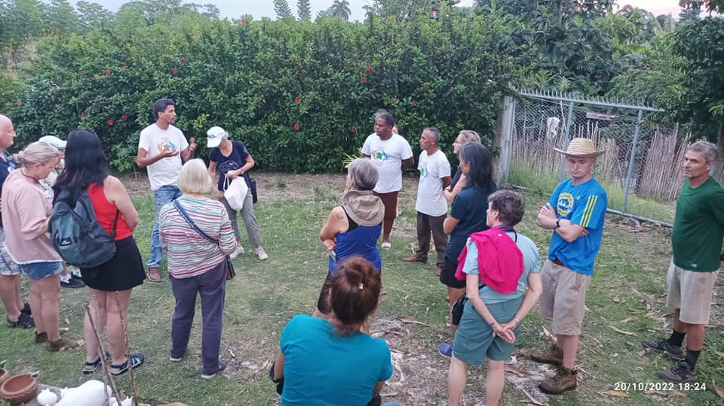
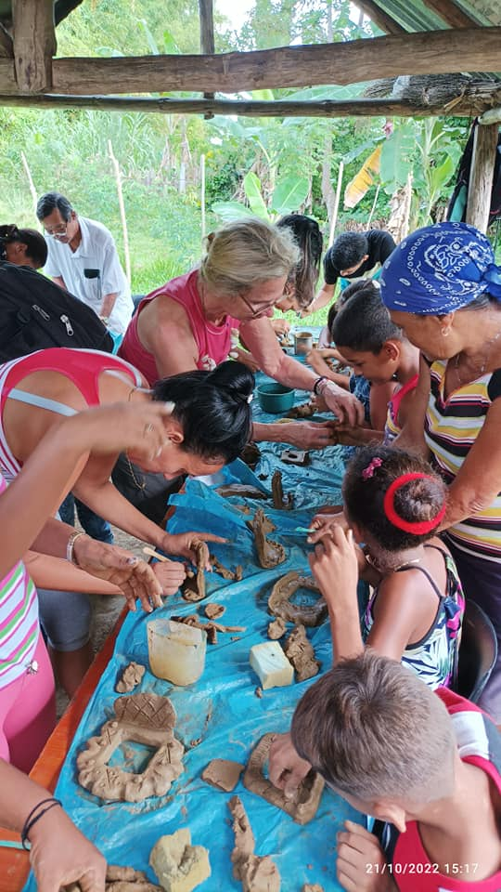
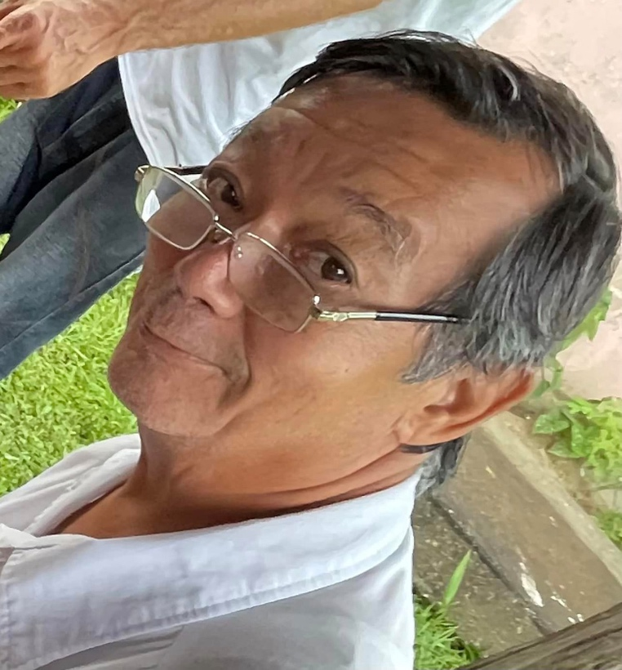
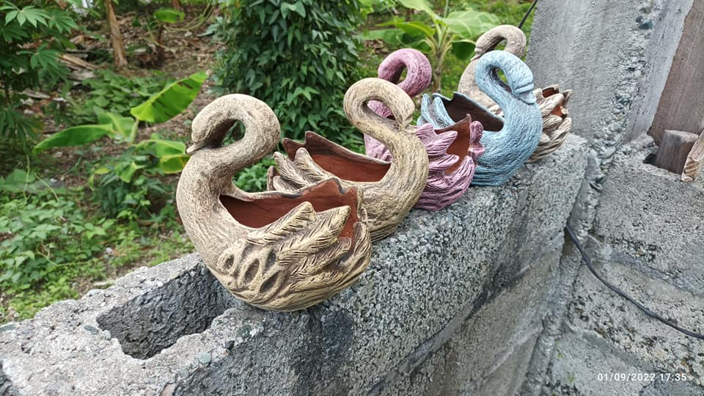
Top L: Our group with TOART colleagues, with Soledad gifting Jorge Luis Vincent (Co-founder and director) with educational materials. Middle—Dr Pun, who works with TOART and sculpts himself. R: Georgia Henkel (blond in top middle) doing a workshop with the children.

Slide 23
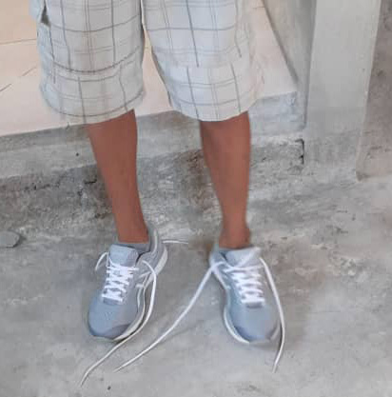
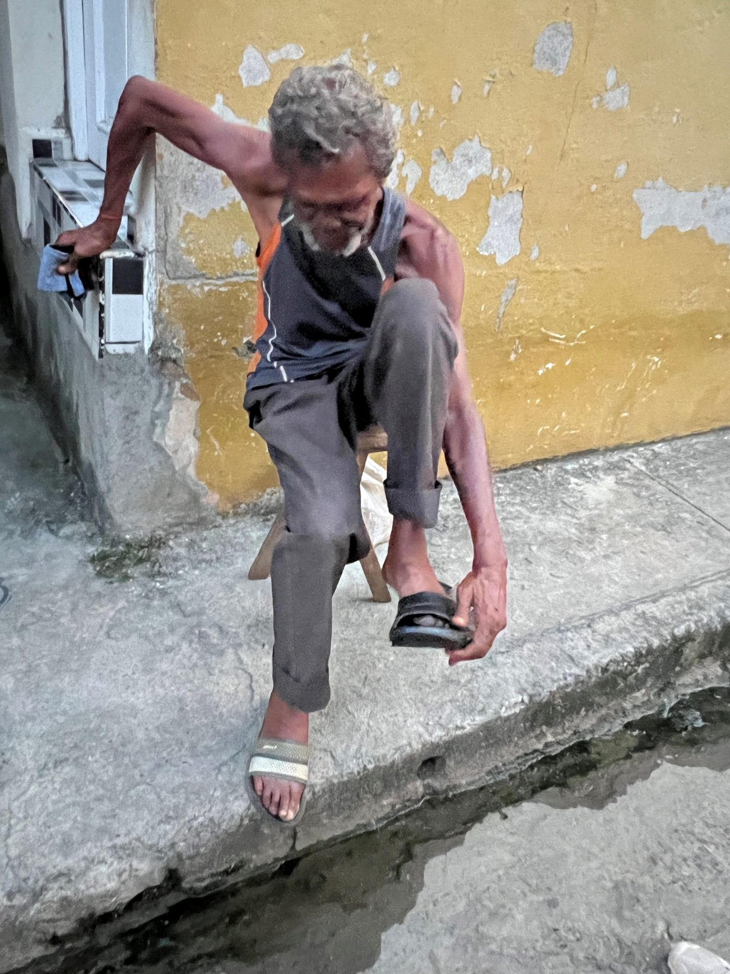
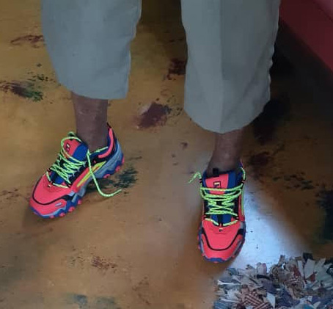
Like many other items, affordable shoes are difficult for Cubans to obtain. With every visit we carry a large number of gently used shoes, many of which are obtained through the generosity of people who attend our local YMCA.
The gentleman on the left is a local street person who after trying on two pairs of shoes finally found a pair of athletic shoes which fit him. He was delighted!

Slide 24
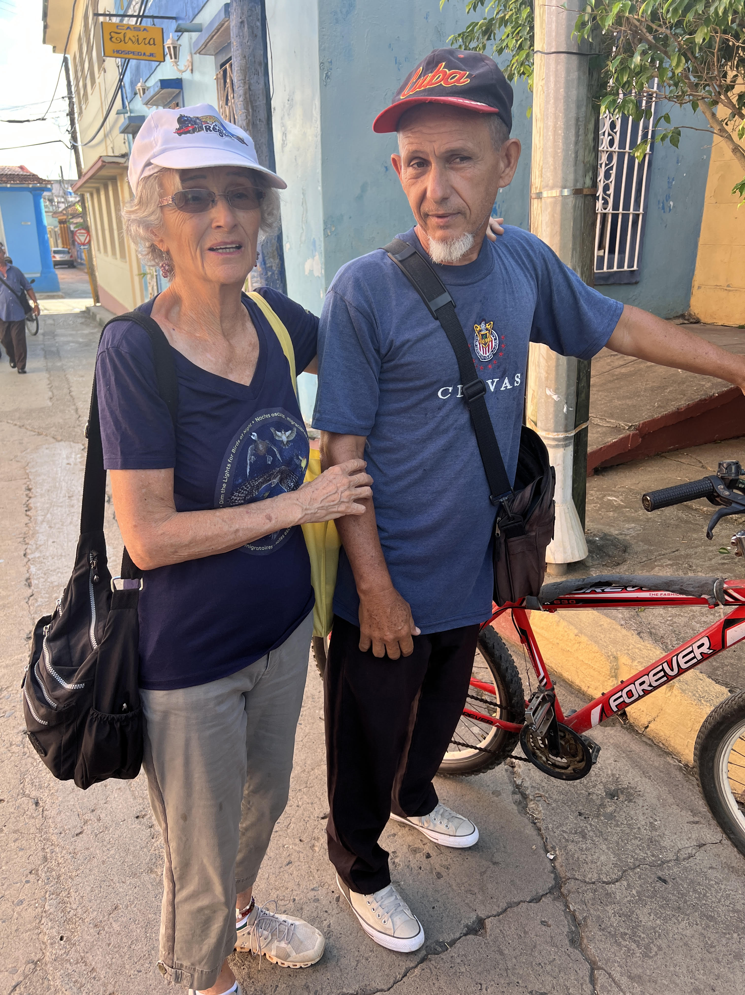
Onolys Mosqueda, Director of the Cuban Association of Persons with Physical Disabilities.
The Friendship Association has a long history of working with Onolys, including assistance with providing independent transport devices for the disabled.

Slide 25
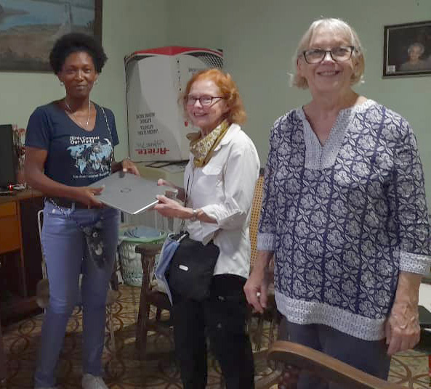
Computers are another item which is difficult for Cubans to obtain. Soledad brings at least one, usually more, computers and cell phones with her every visit.
Kate and Sharyn Thompson are delivering a computer to Ines Fernández , a woman from Santiago, who is a hard worker in educational programs with children about the environment, conservation, and endangered species.

Slide 26
Archaeology is another area in which the Friendship Association has been supportive. This cave was turned into a Taino museum, with the support of the Association
Director Noel Coutín is relating a history about the cave to the group.

Slide 27
Support for the Cubans’ work on behalf of the environment is a major focus for the Friendship Association. The Association has produced numerous coloring books for children (written and illustrated by our Cuban counterparts) which highlight endangered species, as well as a book in both English in Spanish on “The Secrets of the Park” (Humboldt) for the park to make available for sale to visitors. This book is written by a team of biologists, headed by Norvis Hernández, an expert on the endangered polymita snail. This calendar is another production by the Friendship Association.
Taco Bay, Entrance to Humboldt National Park,
a UNESCO World Heritage site.

Slide 28
We hope to continue our trips to Cuba in the spirit of support of and collaboration with the warm and generous people who have made us feel welcome.
If you would like to be a participant in one of these journeys, please sign up on The Friendship Association website friendshipassociation.org or contact Soledad Pagliuca directly at amisoledad@gmail.com

